Slide 1
Migration Policy in Italy and Athens, Greece: a comparative study
IMIP Summer semester 2018

Slide 2
Overview
Scope of the project: a qualitative comparison between migration policies run by the government of Italy and Greece, especially the municipality of Athens
Objective(s): finding key similarities and differences in the two countries; measuring the effects of the policies chosen by the countries

Slide 3
Agenda
Italy - key facts
Migration situation in Italy (current data)
Italy’s migration policy
Greece - key facts
Situation in Greece – and specifically, Athens (current data)
Municipality of Athens’ migration policy
Qualitative comparison between Italy and Greece (particularly Athens)
Conclusions

Slide 4
Italy: key facts
population: 60,56 mln (2016 estimates)
capital city: Rome
official language: Italian
political system: unitary parliamentary republic
GDP/capita: $39.500 (2018 estimate)
religion: 74,4% catholic; 22,6% irreligious; 3% other
non-EU residents population: 3.714.137 (2017 data)
international migrant stock as a percentage of the total population: 10%

Slide 5
Migration situation in Italy
The immigration to Italy is somewhat special - all of the migrants come by boat, so the only route is by the sea;
sea arrivals have increased more than tenfold between 2010 and 2016;
according to academics, about 1/3 of third-country nationals started their lives in Italy as irregular migrants due to lack of sufficient migration policies;
currently, foreigners make up 8,3% of Italian residents.
source: C. Hermanin, “Immigration Policy in Italy: Problems and Perspectives”, Istituto Affari Internazionali Working Papers 17, December 2017

Slide 6
Migration situation in Italy (2018 data)
In 2018, Italy saw over 10.000 sea arrivals. Over 90% of those arrived in Sicily (9.828 people).
Most common nationalities are Tunisian (21,2%) and Eritrean (20,2%).
Between January 2012 and December 2017, UNHCR recorded 14,557 deaths from sea crossings between Libya and Italy.
source: UNHCR data, Mediterranean situation, https://data2.unhcr.org/en/situations/mediterranean (retrieved 23.05.2018)

Slide 7
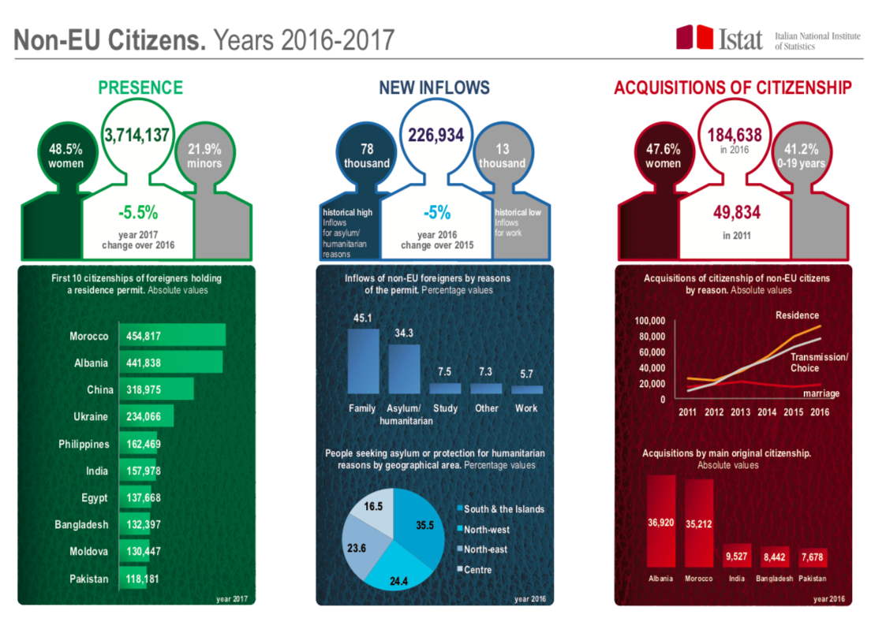
source: ISTAT, NON-EU CITIZENS IN ITALY. YEARS 2016-2017, https://www.istat.it/en/archivio/204326 (retrieved 23.05.2018)

Slide 8
Total foreign resident population, 2002-2017
source: ISTAT data, http://stra-dati.istat.it/?lang=en# (retrieved 23.05.2018)

Slide 9
Annual inflows of non-EU nationals by asylum granted, asylum application and humanitarian reasons, 2007-2016
source: ISTAT data, http://stra-dati.istat.it/?lang=en# (retrieved 23.05.2018)

Slide 10
Migrants arriving to Italy by the sea, 1997-2016
source: Sbarchi e richieste di asilo 1997–2014, Fondazione Ismu.

Slide 11
Unemployment in Italy
In 2017, the unemployment rate among foreign nationals in Italy was reported at 12,6%, while the general rate was 10,8% (OECD).
The situation is especially bad among young people, where the unemployment rate reaches almost 35%.

Slide 12
Unemployment rate among foreign-born population, 2017
source: IOM, Migration Data Portal, https://migrationdataportal.org/?t=2016&i=unemp_foreign&cm49=380 (retrieved 23.05.2018)

Slide 13
Refugees and asylum seekers in Italy
UN DESA (United Nations’ Department of Economic and Social Affairs) estimates that there are about 216.000 refugees in Italy (data as of 2017).
In 2016, UNHCR estimated the total number of asylum seekers in Italy to be 99.900.

Slide 14
Italy’s migration policy
In 2017, the minister of the interior Marco Minniti reached a deal with the Libyan government regarding the treatment of incoming migrants to Italy; the deal included predominately stemming the number of migrants. At the end of November 2017, arrivals from Libya had fallen by 30% compared with the same period in 2016.
Italy is a strong supporter of dropping the “first country” rule, and in return having more solidarity among the member states.
Since late 1980s, when the inflow of migrants from African countries started, Italy has not addressed it in any specific policy.

Slide 15
Forced migration to southern Italy began thirty years ago. In March 1991, 30.000 Albanians arrived in Apulia in one day.
Prior to the migration situation of 2014, Italy did little to set up a proper domestic migration and asylum management system.
Since 2013, the Italian governments made moderate efforts in order to better apply the so-called “Dublin rules” (ie. increasing the number of trained workers in asylum application centres or the creation of specialised court sections for immigration purposes).

Slide 16
In February 2017, the Italian government announced that one of its priorities regarding migration policy will be sending back as many irregular migrants as possible.
The minister of the interior also announced the plans to speed up the asylum process and creation of unpaid workplaces for asylum applicants.
The positive aspects in the guidelines were the announced planned investments in integrated reception and voluntary returns, and transparency commitments.
source: C. Lopez Curzi, 5 things to know about Italy’s plan for immigration, OpenMigration, https://openmigration.org/en/analyses/5-things-to-know-about-italys-plan-for-immigration/ (retrieved 23.05.2018)

Slide 17
Migrant acceptance
About 63% of Italian respondents claimed that the area where they live is a good place to live for immigrants from other countries;
66% responded that they would like to see the immigration level to the country decrease;
18,6% of those surveyed stated that living in an increasingly diversified society is a positive thing.
source: IOM, Migration Data Portal, https://migrationdataportal.org/?t=2016&i=betterplace&cm49=380 (retrieved 23.05.2018)

Slide 18
Situation in Greece
Greece has been traditionally one of the most important emigration countries following the Second World War - mainly for economic reasons.
From the beginning of the 1990s, Greece started receiving large inflows of immigrants from Central and Eastern Europe following the collapse of the communist regimes, with a large number of migrants from Albania.
From 2007, the number of irregular migrants and asylum seekers arriving in Greece by boat (from Pakistan, Bangladesh, Iraq, Afghanistan, among others) through the Aegean Sea increased significantly.
However, as from 2010, a shift from the sea to the land border has taken place, resulting in increased illegal border crossings at the Greek land border with Turkey, which constitute approximately 85 per cent of all the detections of illegal border crossing at the EU level.

Slide 19
Situation in Greece (2017 data)
Greece as a gateway to the European Union
Population – 11.145.189
Immigrants to Greece reached a peak in 2015 – roughly one million
particularly from the Eastern Mediterranean sea through Greek – Turkey route
Main immigrants - Syria, Afghanistan, Iraq, Pakistan

Slide 20
The census indicated that the number of immigrants living in Greece in 2001 was 762,191, making up approximately 7 percent of the total population
However, in 2016, immigrants composed of 1,220,395 people – approximately 11% of the population

Slide 22
Italy: key facts
population: 60,56 mln (2016 estimates)
capital city: Rome
official language: Italian
political system: unitary parliamentary republic
GDP/capita: $39.500 (2018 estimate)
religion: 74,4% catholic; 22,6% irreligious; 3% other
non-EU residents population: 3.714.137 (2017 data)
international migrant stock as a percentage of the total population: 10%

Slide 23
https://www.iom.int/countries/greece
Greece has become the refugees’ first gate entry into the EU
According to the UNHCR, 10,304 refugees resided in Greece in 2014. In 2014, 7,585 first time asylum applications were made, down from 7,860 in 2013 (Eurostat Greece has become the refugees’ first gate entry into the EU data). In 2014 the top three citizenships of asylum applicants were Afghanistan (1,710), Pakistan (1,620) and Syria (785).
The majority of refugees arriving in Greece do not apply for asylum there. They leave Greece (and the EU) transiting through Balkans and Hungary (where they re-enter the EU), towards Western and Northern European destinations.
In particular, the Greek islands struggle with the influx of people; some of the islands lack registration and reception centres. Police clashes with refugees are reported.
Recently, following deaths and the number of people missing at sea, refugees increasingly choose to cross the Turkish-Greek land border.

Slide 24
Greece has been traditionally one of the most important emigration countries following the Second World War.
Bilateral agreement between the Greek Government and IOM (ICEM).
National emigration flows lasted from 1952 to the mid 1970s. Since 1954, the Organization had initiated and offered vocational training courses to Greek workers, providing them with professional background, as well as cultural orientation to facilitate their integration into the host society. The IOM mission in Greece has assisted over 140,000 Greek national emigrants who settled in the United States, Canada, Australia and other countries.
From 2007, the number of irregular migrants and asylum seekers arriving in Greece by boat (from Pakistan, Bangladesh, Iraq, Afghanistan, among others) through the Aegean Sea increased significantly. However, as from 2010, a shift from the sea to the land border has taken place, resulting in increased illegal border crossings at the Greek land border with Turkey, which constitute approximately 85 per cent of all the detections of illegal border crossing at the EU level. These large influxes of irregular migrants from Asia and Africa, who view Greece as a gateway to the European Union, end up being stranded in the country.
Through these years, and in order to cope with this situation, the Greek state implemented three regularization exercises. The main legislative instrument on migration is Law 3386/2005, “Entry, residence and social integration of third country nationals into the Greek territory”, providing for the unification of the residence and work permits, as well as introducing the “reflection period” for victims of trafficking. It has been revised under Law 3536/2007, “Determining matters in migration policy and other issues falling into the competence of the Ministry of Interior, Public Administration and Decentralization”.
https://www.iom.int/countries/greece

Slide 25
In 2011 the European Court of Justice found that 90 per cent of all irregular entry into Europe was through the Greek borders. According to data from Frontex, Greece is the major gateway of undocumented migrants and asylum seekers from Africa and Asia. Entry points into Greece have also changed. In the past the usual route was by boat through the Aegean Sea. Assistance from Frontex in patrolling the sea borders has resulted in a shift to entry by land, especially at the Evros border. Law 3907/2011 is an attempt to establish a realistic migration management system, through the operation of an independent Asylum Service, the establishment of First Reception Centers and the adaptation of Greek legislation to Community Directive 2008/115/EC on the return of irregular migrants.
IOM also carries out counter trafficking activities, through partnerships with the National Coordinating Mechanism, the Hellenic Police, other Ministries and civil society, and provides support to NGOs, as well as the implementation of voluntary returns of victims of trafficking.

Slide 26
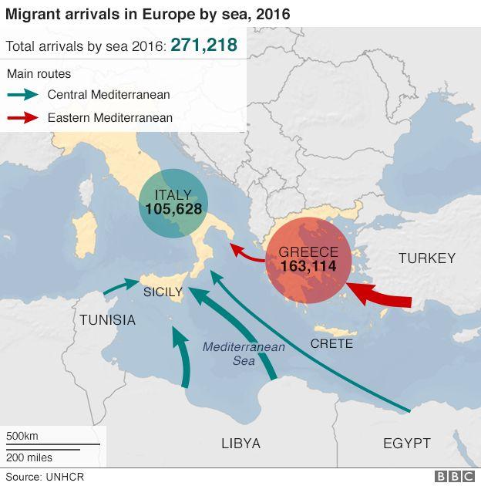

Slide 27
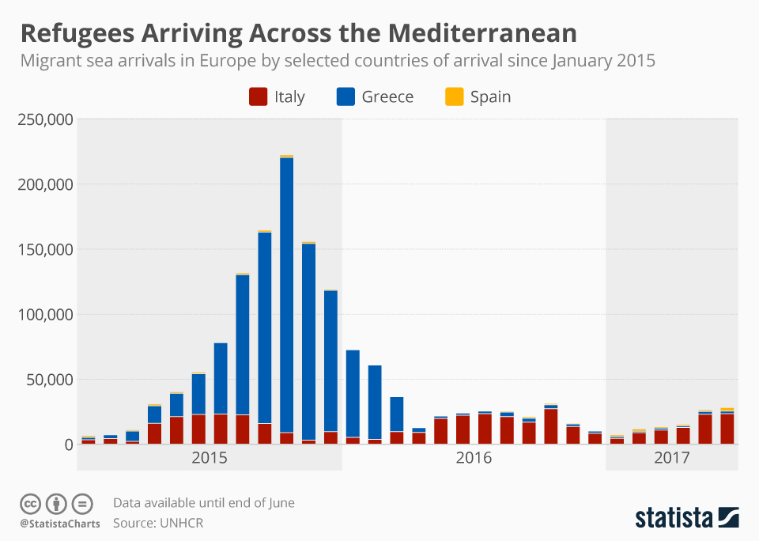

Slide 28
https://www.bing.com/images/search?view=detailV2&ccid=5gGCf0uf&id=6EB394D01CD99C26A51563BDFD599E60C37989D8&thid=OIP.5gGCf0uf3mPzcF-pvGdpJgHaFR&mediaurl=https%3a%2f%2fd28wbuch0jlv7v.cloudfront.net%2fimages%2finfografik%2fnormal%2fchartoftheday_4446_refugee_crisis_in_greece_n.jpg&exph=684&expw=960&q=statistics+for+Greece++seekers+&simid=608054345054619827&selectedIndex=0&ajaxhist=0

Slide 29
https://www.bing.com/images/search?view=detailV2&ccid=3pPRfeGU&id=81D4F2BD5A7BA7961E94B10EDDBB32E6378F09F4&thid=OIP.3pPRfeGUNvzuyGxMa3g7rwHaJk&mediaurl=https%3a%2f%2fcdn.static-economist.com%2fsites%2fdefault%2ffiles%2fimages%2f2015%2f09%2fblogs%2feconomist-explains%2f20150912_woc665.png&exph=750&expw=580&q=statistics+for+Greece++seekers+&simid=608042705740827226&selectedIndex=7&ajaxhist=0

Slide 30
https://www.bing.com/images/search?view=detailV2&ccid=Q5F27jip&id=75CD3DA100AC2E5E519914986FABD62A40028650&thid=OIP.Q5F27jipOB7iqGcMMKzx1AHaGz&mediaurl=http%3a%2f%2flinkis.com%2furl-image%2fhttp%3a%2f%2fcdn.static-economist.com%2fsites%2fdefault%2ffiles%2fimages%2f2015%2f09%2fblogs%2fgraphic-detail%2f20150926_woc853_1.png&exph=1094&expw=1190&q=statistics+for+Greece+asylum+seekers&simid=607997776075426965&selectedIndex=44&ajaxhist=0

Slide 31
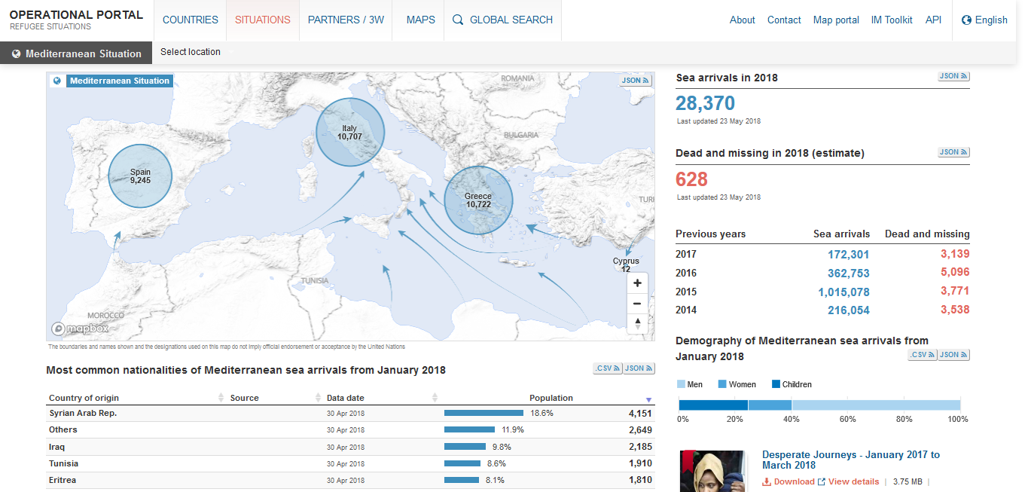
http://data2.unhcr.org/en/situations/mediterranean

Slide 32
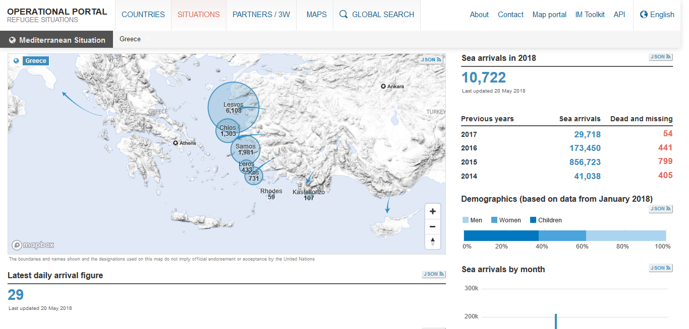
http://data2.unhcr.org/en/situations/mediterranean/location/5179

Slide 33
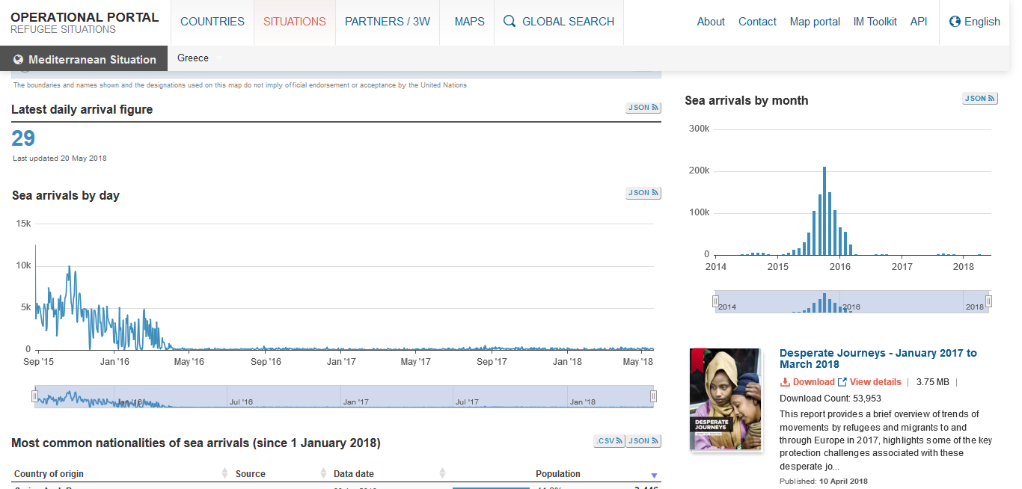
http://data2.unhcr.org/en/situations/mediterranean/location/5179

Slide 35
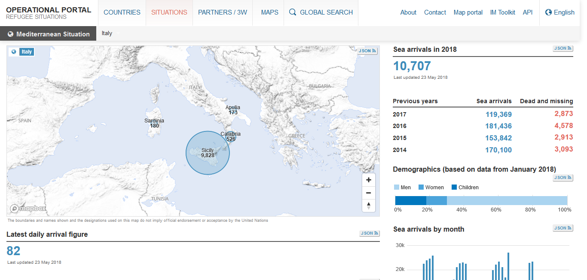
http://data2.unhcr.org/en/situations/mediterranean/location/5205

Slide 36
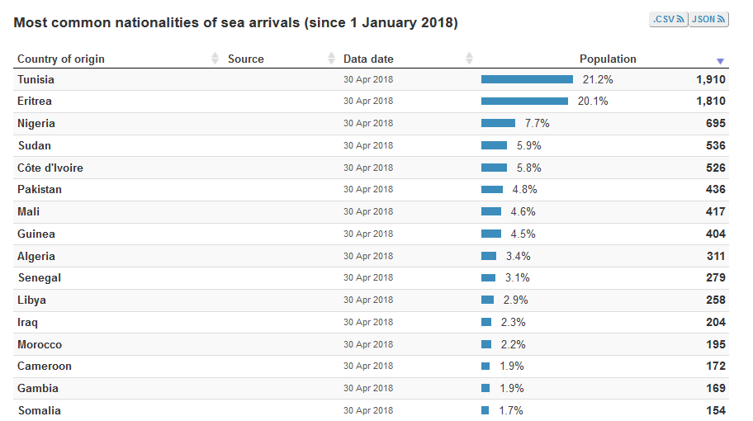

Slide 37
https://www.bing.com/images/search?view=detailV2&ccid=VFPtwG2B&id=9F06C56848166F55F9AC958C62C8D4BF4D2A0613&thid=OIP.VFPtwG2BqRoFwbhu8fp3EgHaFR&mediaurl=http%3a%2f%2finfographic.statista.com%2fnormal%2fchartoftheday_4645_greece_s_largest_refugee_site_in_numbers_n.jpg&exph=684&expw=960&q=statistics+for+Greece++seekers+&simid=608038999202008038&selectedIndex=2&ajaxhist=0

Slide 38
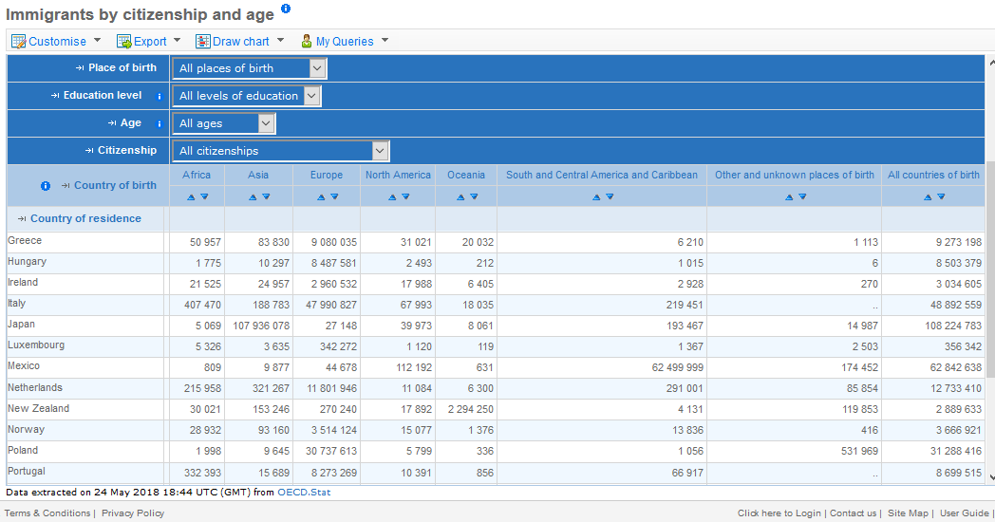
https://stats.oecd.org/Index.aspx?DataSetCode=MIG

Slide 39
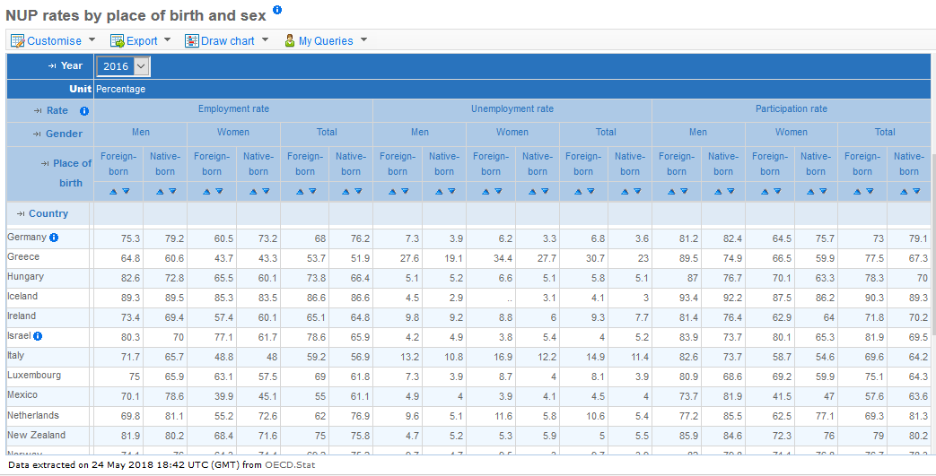
https://stats.oecd.org/Index.aspx?DataSetCode=MIG

Slide 40
http://migration.iom.int/europe/
Main nationalities of arrivals (in descendant order):
To Italy: Eritrea, Tunisia, Nigeria, Pakistan, Côte d’Ivoire (March 2018)
To Greece: Syrian Arab Republic, Iraq, Afghanistan, Cameroon, Democratic Republic of the Congo (March 2018)

Slide 41
http://www.asylumineurope.org/reports/country/greece

Slide 42
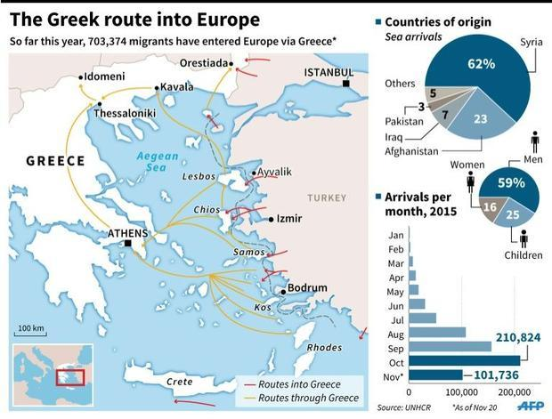

Slide 43
EU’s Role in Greece
EU deal with Turkey
Stems the flow of Syrian refugees entering Greece with a cap at 72,000
Returns Syrian refugees illegally entering Greece and takes Syrian refugees from Turkey on a one-to-one basis
Emergency Support to Integration and Accommodation (ESTIA) is funded by the EU and provides urban accommodation and cash assistance
Should be passed to the Greek government in January 2019
Mostly just in mainland Greece
Frontex’s Operation Poseidon
Covering Greek land and sea borders since 2011
Rönsberg, Andrea. “EU-Turkey Migrant Deal Done | DW | 18.03.2016.” DW.COM, 18 Mar. 2016, www.dw.com/en/eu-turkey-migrant-deal-done/a-19127595.
Halais, Flavie. “Why the EU's Flagship Refugee Program in Greece Faces an Uncertain Future.” Devex, 30 Jan. 2018
Afouxenidis, Alex, et al. “Dealing with a Humanitarian Crisis: Refugees on the Eastern EU Border of the Island of Lesvos.” Journal of Applied Security Research, vol. 12, no. 1, 12 Jan. 2017, pp. 20.
http://estia.unhcr.gr/en/home/

Slide 44
“the primary focus [is] on the deterrence and apprehension of irregular arrivals”
Afouxenidis, Alex, et al. “Dealing with a Humanitarian Crisis: Refugees on the Eastern EU Border of the Island of Lesvos.” Journal of Applied Security Research, vol. 12, no. 1, 12 Jan. 2017, pp. 18.

Slide 45
National Action Plan for Migration Management
Created by the Ministry of Citizen Protection (government department concerning Greece’s public security services)
Placing the responsibility with this ministry shows Greece thinks of the migration crisis as a security issue
Included following intiatives:
Establishment of a First Reception Service by creating Screening Centers
Creation of an Asylum Service independent from the Hellenic Police
Modernization of existing preremoval centers and construction of new centers to cover immediate needs
Introduction of new procedures and support for vulnerable groups
Afouxenidis, Alex, et al. “Dealing with a Humanitarian Crisis: Refugees on the Eastern EU Border of the Island of Lesvos.” Journal of Applied Security Research, vol. 12, no. 1, 12 Jan. 2017, pp. 18.
Notes:
Pg.18

Slide 46
“under Greek law an irregular migrant is considered a criminal offender”
Detainment can be used “to create order and manage public fears about immigration”
Afouxenidis, Alex, et al. “Dealing with a Humanitarian Crisis: Refugees on the Eastern EU Border of the Island of Lesvos.” Journal of Applied Security Research, vol. 12, no. 1, 12 Jan. 2017, pp. 22.

Slide 47
Detainment
Allowed length of detainment:
Before 2009: 3 months
2012: 18 months
Now: Greek Legal Council “allows the police to extend the length of detention beyond 18 months and prolonging detention indefinitely if they were considered to be noncompliant” (Furman 81)
If the purpose is to deter, allowance of prolonged detainment with poor conditions helps to do just that
Three main functions:
Coerce detainees into complying with removal procedure and leaving the country or deterring new arrivals
Incapacitate a marginal population
Communicate that the state is in control
Furman, Rich, et al. Detaining the Immigrant Other: Global and Transnational Issues. Oxford University Press, 2016, pp 81.
Afouxenidis, Alex, et al. “Dealing with a Humanitarian Crisis: Refugees on the Eastern EU Border of the Island of Lesvos.” Journal of Applied Security Research, vol. 12, no. 1, 12 Jan. 2017, pp. 22.

Slide 48
Opening and Closing Borders
Opening of the Greek-FYROM border in 2015
In just August 2015, 39,000 refugees and migrants went through FYROM on their way to Western Europe
Construction of the border wall at Evros as a practical solution and a symbol of Greek strength
Migration fell by 90% in this area, but true success cannot be measured
Operation Shield and enhanced surveillance at the Evros Border
Funded by the EU External Borders Fund
Purpose: deter migrants and effectively seal borders
Afouxenidis, Alex, et al. “Dealing with a Humanitarian Crisis: Refugees on the Eastern EU Border of the Island of Lesvos.” Journal of Applied Security Research, vol. 12, no. 1, 12 Jan. 2017, pp. 15, 20-21.

Slide 49
Management of Aid
National Register created by the General Secretariat for Migration Policy in September 2016
All non-governmental organizations working with refugees on the Greek islands have to register themselves and their volunteers
Thought of as an attempt at state control by some international watchdog organizations
Hellenic Republic, Ministry of Interior and Administrative Reconstruction, Establishment of a National Register of Greek and Foreign Non-Governmental Organizations (NGOs) Active in the Field of International Protection, Migration and Social Integration Issues. 2016.
“NGOs and Volunteers Helping Refugees in Greece to Be Placed under State Control.” Statewatch News Online: EU: Refugee Crisis: Greece:Volunteers under State Control, 21 Feb. 2016, statewatch.org/news/2016/feb/eu-med-crisis-volunteers-state.htm.

Slide 50
Athens’ migration policy
ESTIA provides urban accommodation and cash assistance in Athens
Camp Elaionas is in the heart of Athens and allows residents to move in and out of the camp at will
Poor conditions but better than the islands
Athens Coordination Center for Migrant and Refugee Issues (ACCMR) operates within the Vice-Mayor’s Office for Migrants and Refugees
Encourages innovative projects to ensure efficient of resources
Creating a Strategic Action Plan for integration of migrants and refugees into the city and a Preparedness Mechanism for refugee-related emergencies
http://estia.unhcr.gr/en/home/
Papadimitriou, Jannis. “Elaionas: a Refugee Camp in the Heart of Athens.” InfoMigrants, 12 Jan. 2018, www.infomigrants.net/en/post/6988/elaionas-a-refugee-camp-in-the-heart-of-athens.
https://www.accmr.gr/en/

Slide 53
Bibliography
C. Hermanin, “Immigration Policy in Italy: Problems and Perspectives”, Istituto Affari Internazionali Working Papers 17, December 2017
http://estia.unhcr.gr/en/home/
https://www.accmr.gr/en/
Rönsberg, Andrea. “EU-Turkey Migrant Deal Done | DW | 18.03.2016.” DW.COM, 18 Mar. 2016, www.dw.com/en/eu-turkey-migrant-deal-done/a-19127595.
Afouxenidis, Alex, et al. “Dealing with a Humanitarian Crisis: Refugees on the Eastern EU Border of the Island of Lesvos.” Journal of Applied Security Research, vol. 12, no. 1, 12 Jan. 2017, pp 15, 18,. 20-22.
Halais, Flavie. “Why the EU's Flagship Refugee Program in Greece Faces an Uncertain Future.” Devex, 30 Jan. 2018, www.devex.com/news/why-the-eu-s-flagship-refugee-program-in-greece-faces-an-uncertain-future-91773.
https://www.iom.int/countries/greece
Rönsberg, Andrea. “EU-Turkey Migrant Deal Done | DW | 18.03.2016.” DW.COM, 18 Mar. 2016, www.dw.com/en/eu-turkey-migrant-deal-done/a-19127595.

Slide 54
Furman, Rich, et al. Detaining the Immigrant Other: Global and Transnational Issues. Oxford University Press, 2016, pp 81.
Hellenic Republic, Ministry of Interior and Administrative Reconstruction, Establishment of a National Register of Greek and Foreign Non-Governmental Organizations (NGOs) Active in the Field of International Protection, Migration and Social Integration Issues. 2016.
“NGOs and Volunteers Helping Refugees in Greece to Be Placed under State Control.” Statewatch News Online: EU: Refugee Crisis: Greece:Volunteers under State Control, 21 Feb. 2016, statewatch.org/news/2016/feb/eu-med-crisis-volunteers-state.htm.
Papadimitriou, Jannis. “Elaionas: a Refugee Camp in the Heart of Athens.” InfoMigrants, 12 Jan. 2018, www.infomigrants.net/en/post/6988/elaionas-a-refugee-camp-in-the-heart-of-athens.
http://data2.unhcr.org/en/situations/mediterranean
https://www.migrationpolicy.org/article/greece-illegal-immigration-midst-crisis/
https://populationworld.com/greece-population/
http://www.worldometers.info/world-population/greece-population/
https://www.statista.com/statistics/548863/foreign-born-population-of-greece/

