Slide 1
Immigration Situation and Immigration Policy in the EU Member States
Fall semester 2018/2019
Presented on 8.01.2019
GAUTHIER JAUNET MYKOLA KRYVITSKYI JAKUB LISOWSKI

Slide 2
Immigration crisis in Europe
A comparison between arrival countries in the Mediterranean and destination countries in Northern Europe using the examples of Italy, Greece and Denmark.

Slide 3
Structure:
Introduction
Context
Immigration situation
Immigration policies
Comparison between Greece, Italy and Denmark
Possible issues for Europe
Conclusion

Slide 4
Introduction

Slide 5
Objectives
Analyse the immigration situation
Evaluate immigration policies
Contrast Greece, Italy and Denmark in multiple areas
Critically assess the countries’ responses to increased immigration
Suggest improvements to solve existing problems and prevent more in the future

Slide 6
Scope and justification
The presentation focuses on the European refugee crisis of 2015 through the scope of three countries: Greece, Italy and Denmark. Both the immigration situation as well as specific policies are analysed, including the historical context. The findings are then compared and improvements are suggested on the basis of the findings.
The countries were chosen in order to compare Mediterranean arrival countries with a destination country in Northern Europe such as Denmark. Comparing the immigration situation as well as specific policies helps paint a detailed picture of the differences in the attitudes and experiences of mass migration in these drastically different regions of Europe.

Slide 7
Research questions
Why do immigration figures relate to the numbers of asylum applicants in a given country?
What are the main differences in immigration policy between Greece, Italy and Denmark?
How can immigration policy be improved to deal with current and future issues related to migration?
What was the impact of the European migrant crisis on economic, demographic, social aspects in these countries?
What are the issues arising from mass migration in the Mediterranean?

Slide 8
Research methods
Literature review: academic papers are analysed with regards to the research questions.
Quantitative analysis: data related to migration is analysed and findings are presented.
Qualitative analysis of political discourse and social attitudes towards immigration is performed.

Slide 9
Context

Slide 10
European refugee crisis
2015 -
pattern of increased migration since mid-20th century
Mediterranean arrivals: Syrians (46.7%), Afghanis (20.9%) and Iraqis (9.4%) in 2015
over 14,000 dead or missing since 2015 in the Mediterranean
Europe only a small part of worldwide migration flows
UNHCR data portal - Situations. Mediterranean Situation. Available at https://data2.unhcr.org/en/situations/mediterranean. Retrieved 1 Jan 2019.

Slide 11
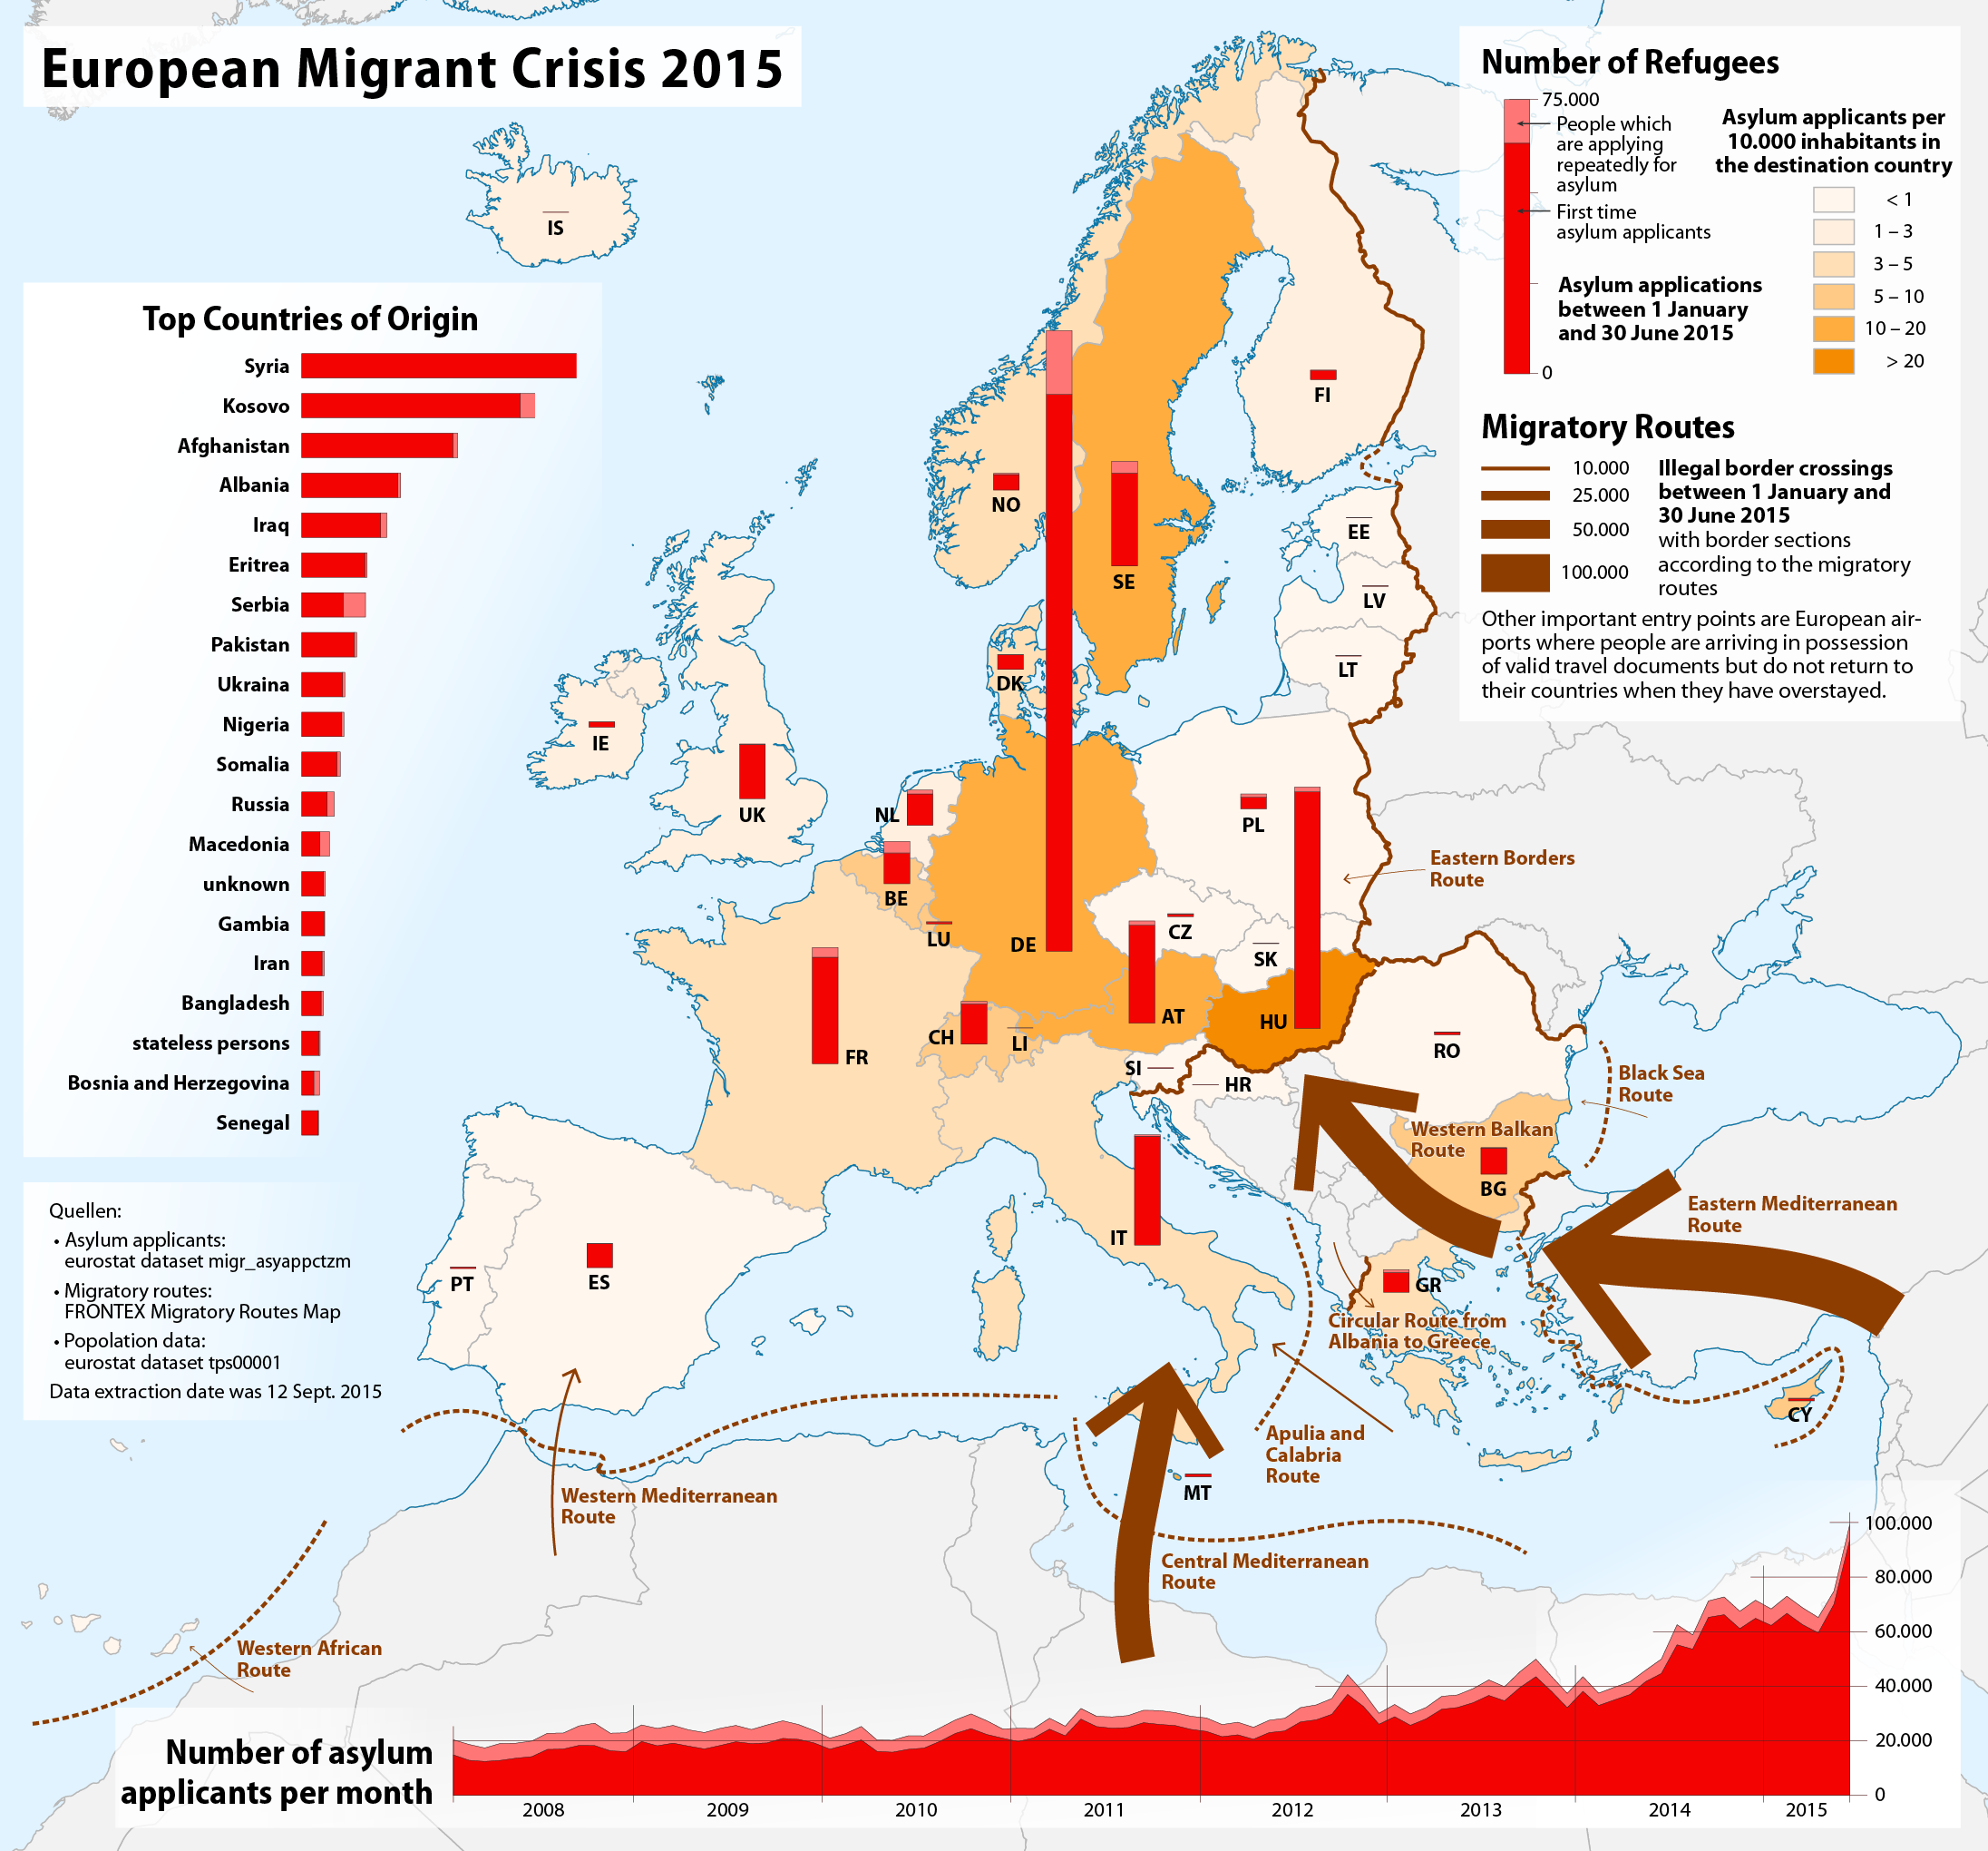
Eastern Mediterranean route is the most prominent
Asylum applicants as % of population are similar for Italy, Greece and Denmark
Predominantly first-time asylum applicants in all countries
Surge in asylum applications in 2015
Dörrbecker, M. (2015). European migrant crisis. Asylum applicants in Europe between 1 January and 30 June 2015 [Map]. Available at https://en.wikipedia.org/wiki/European_migrant_crisis, Retrieved 1 Jan 2019.

Slide 12
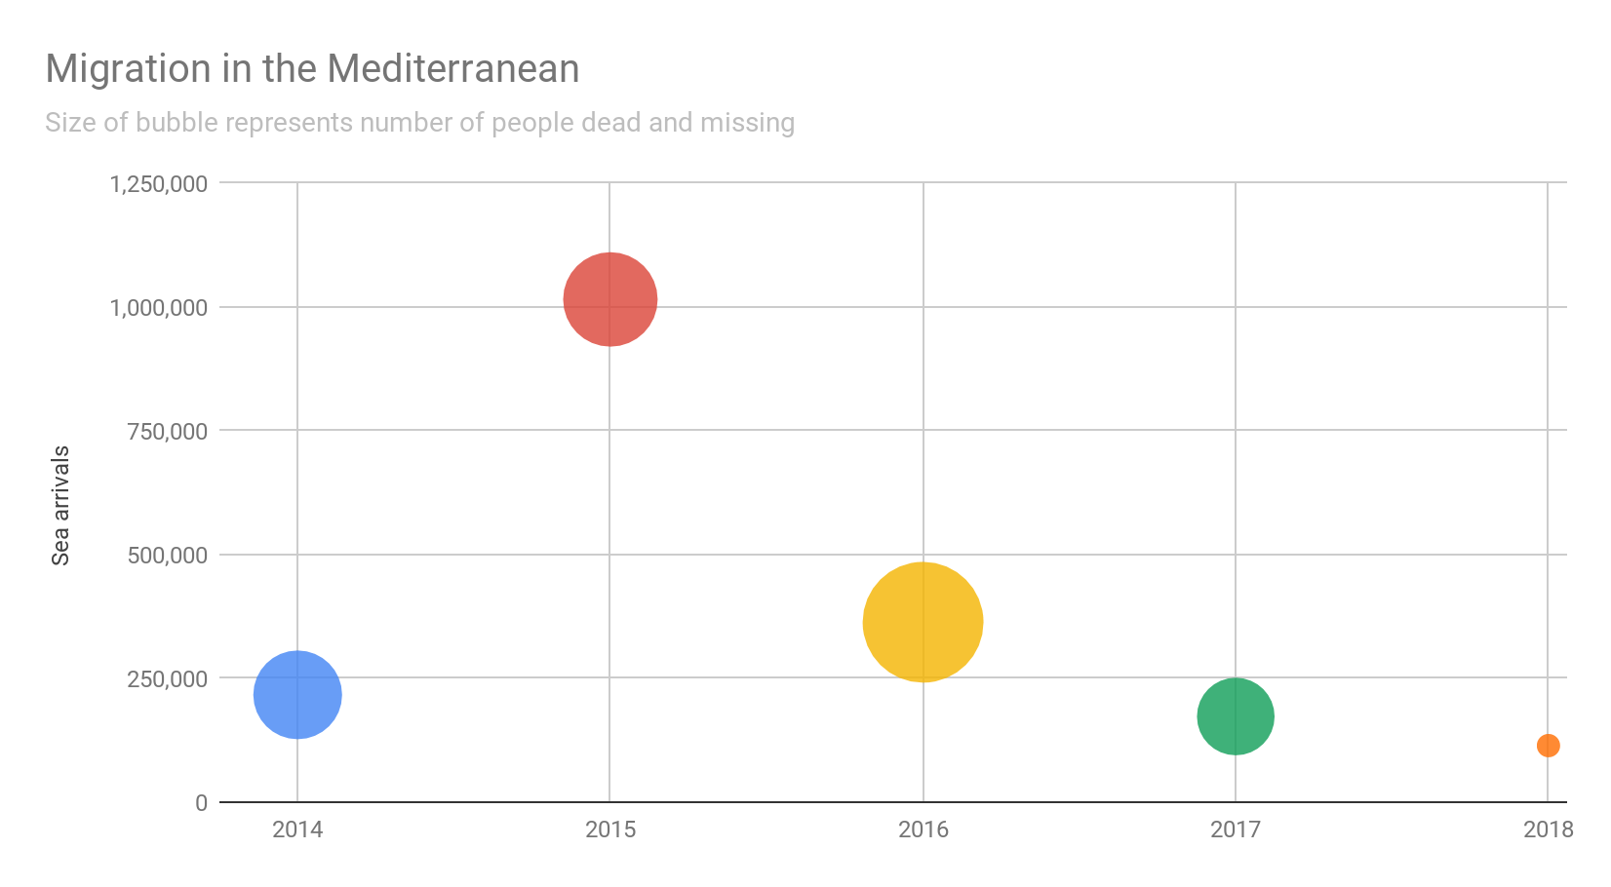
Own interpretation based on UNHCR data. Available at https://data2.unhcr.org/en/situations/mediterranean. Retrieved 1 Jan 2019.

Slide 13
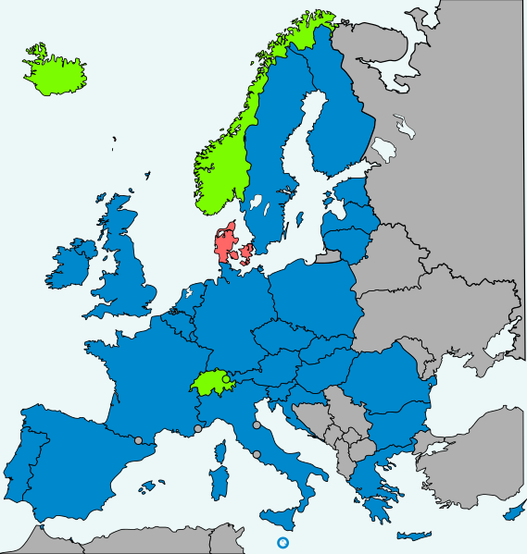
States applying Dublin instruments
Dublin regulation
EU-Denmark agreement
non-EU member states with an agreement to apply the provisions
Framework for asylum applications in Europe
Refugees must apply for asylum in country of arrival to the EU
Gives countries the right to deport refugees to country of arrival
Highly controversial and criticised by human rights groups
First signed in 1990, amendments adopted in 2003 and 2013.
Partially suspended in 2015 by multiple countries
States applying Dublin instruments [Map]. (2014, November 10). In Wikipedia. Retrieved January 5, 2019, from https://en.wikipedia.org/wiki/Dublin_Regulation

Slide 14
Immigration situation

Slide 15
Greece
until the 1970s - country of emigration
large numbers of immigrants over the last three decades
initially from Balkans and Eastern Europe, later from Asia and Africa (Figgou, 2016)
estimates of 1,300,000 migrants, 390,000 undocumented (Maroukis, 2012)
over 1,000,000 sea arrivals since 2015
UNHCR data portal - Situations. Mediterranean Situation. Available at https://data2.unhcr.org/en/situations/mediterranean. Retrieved 1 Jan 2019.

Slide 16
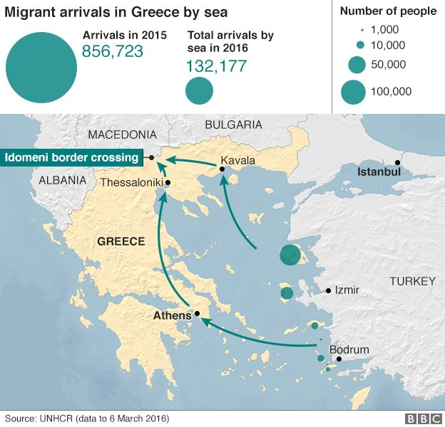
Vast majority of migrants in 2015 arrived in the EU through Greece
Border crossing with Macedonia a controversial issue
Despite the high volume of sea arrivals, much safer than the Central Mediterranean route
Sharp decrease in arrivals between 2015 and 2016
BBC. (2016). Migrant crisis: Hundreds cross from Greece into Macedonia. Retrieved January 3, 2019, from https://www.bbc.com/news/world-europe-35805010

Slide 17
Italy
in the past a country of mass emigration, now increasingly larger immigrant population
5,144,440 foreigners resident in Italy as of Jan 1st 2018
Three largest immigrant groups resident in Italy: Romanians (1,190,091), Albanians (440,465) and Moroccans (416,531)
nearly 500,000 sea arrivals since 2015
UNHCR data portal - Situations. Mediterranean Situation. Available at https://data2.unhcr.org/en/situations/mediterranean. Retrieved 1 Jan 2019.
ISTAT. (n.d.). Resident foreigners on 1st January - Citizenship. Retrieved January 5, 2019, from http://stra-dati.istat.it/Index.aspx

Slide 18
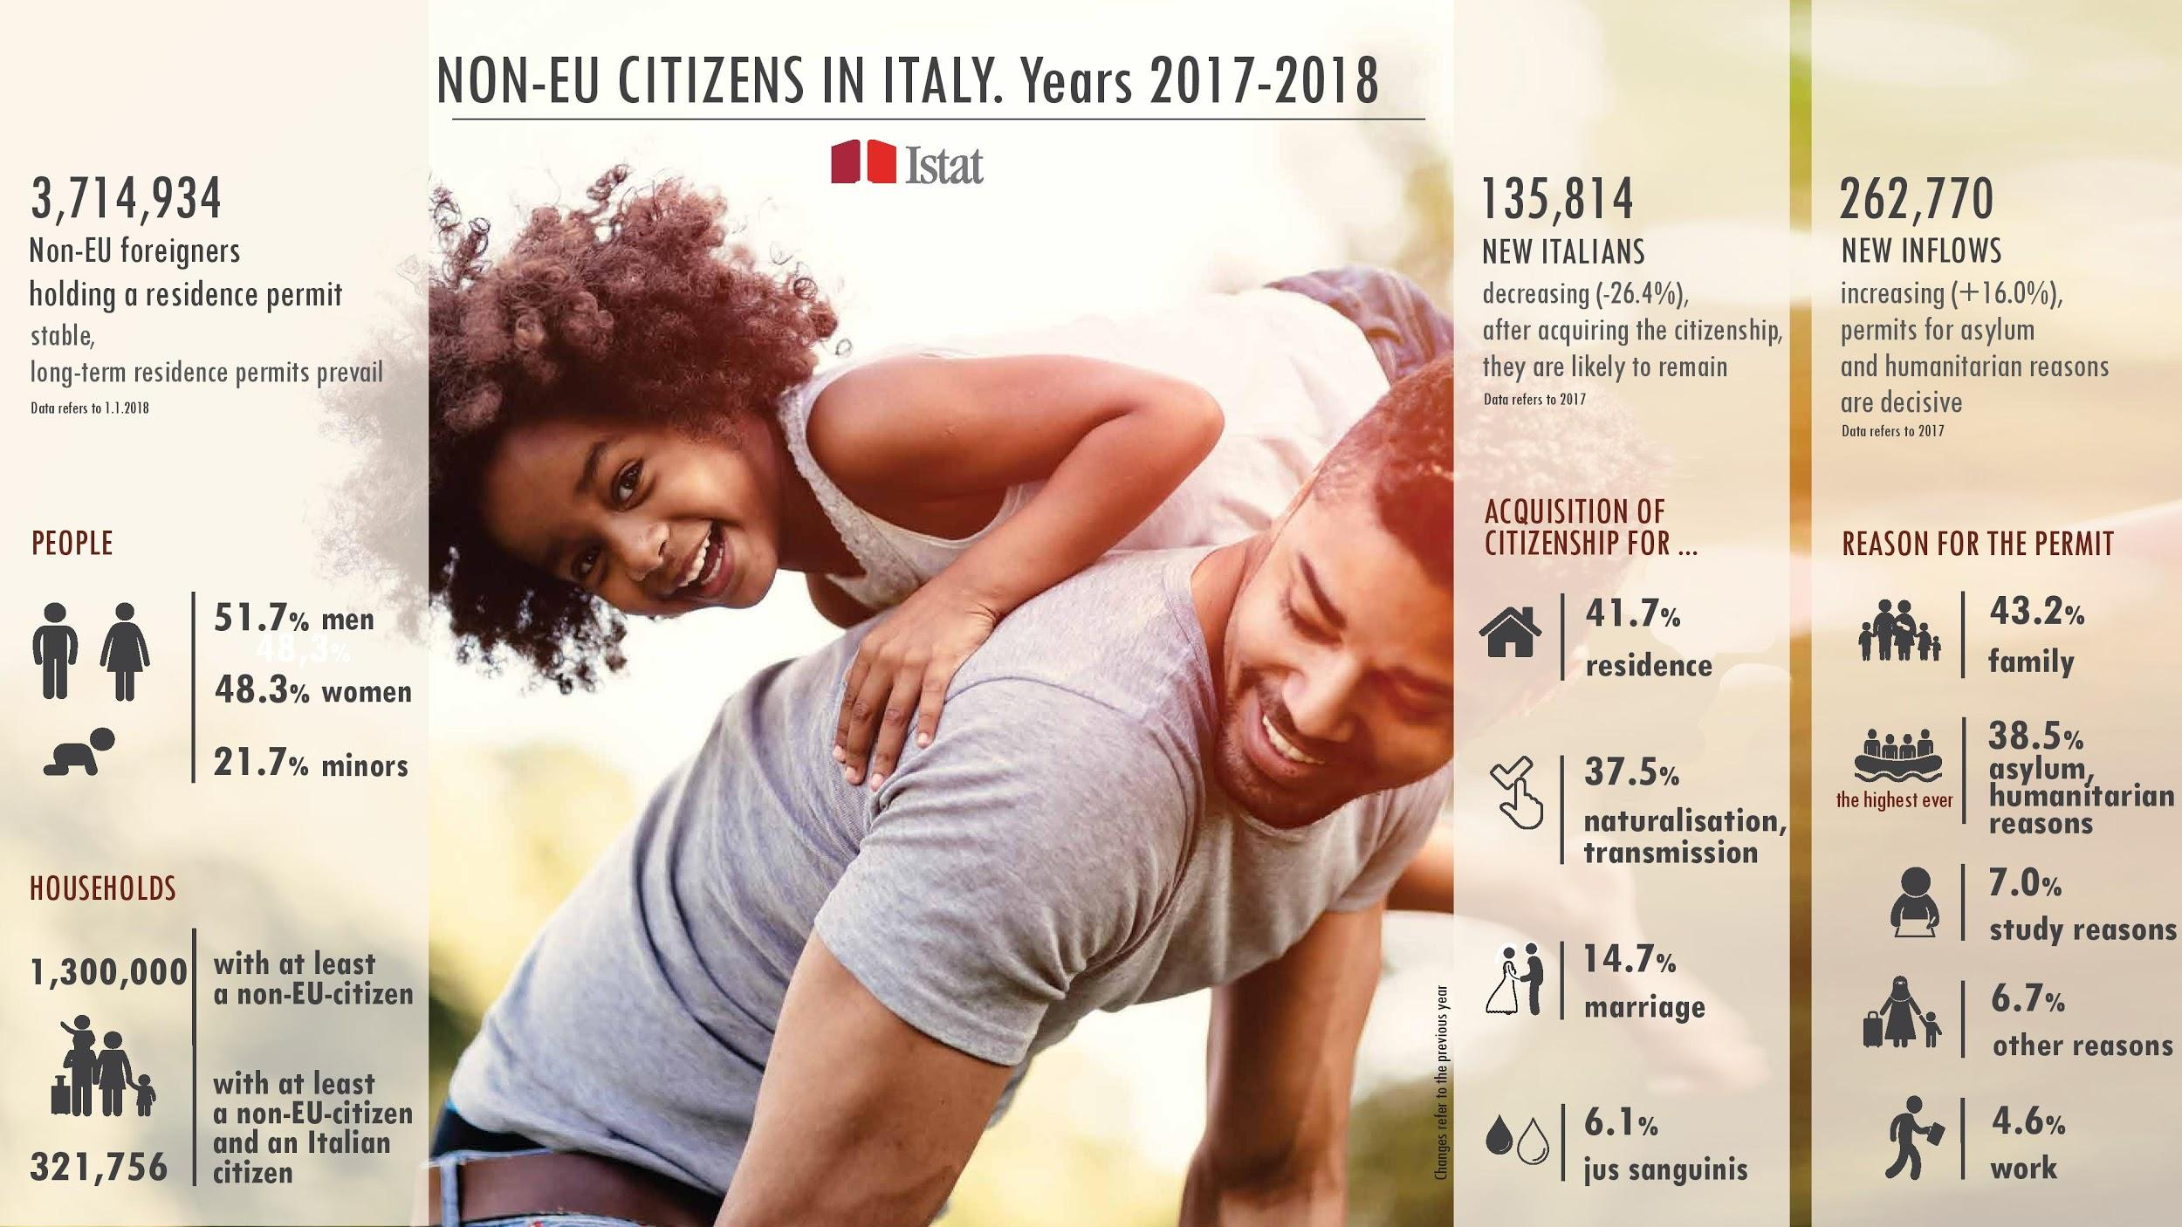
Istat, Population and Households. (2018, November 26). NON-EU CITIZENS: PRESENCE, NEW INFLOWS AND ACQUISITION OF CITIZENSHIP [Press release]. Retrieved January 5, 2019, from https://www.istat.it/en/archivio/224319

Slide 19
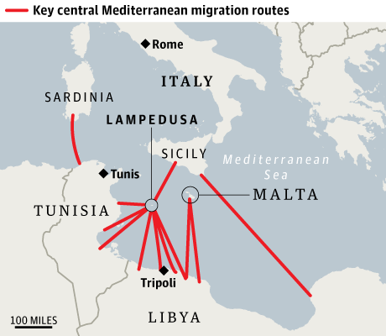
Distances travelled between North Africa and Italy/Malta are significant which leads to many deaths in this part of the Mediterranean
Accounts for the majority of dead or missing persons according to UNHCR data
Less than half the sea arrivals since 2015 compared to Greece
Multiple routes from both Libya and Tunisia
Davies, L. (2014, June 25). Europe's migrant influx: 'we need help but we don't know where from'. Retrieved January 5, 2019, from https://www.theguardian.com/world/2014/jun/25/-sp-boat-migrants-risk-everything-for-a-new-life-in-europe

Slide 20
Denmark
rapid increase in immigration in the 1960s, mainly for labour
immigration heavily limited since
351,182 immigrants from ‘non-western countries’ living in denmark in Q4 2018
10,849 resident permits on the basis of asylum granted in 2015 (21,000 applications)
over 4,000 new Danish citizens in 2015 from outside the EU

Slide 21
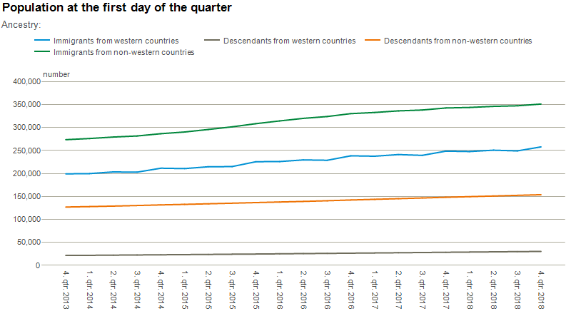
Immigrants and their descendants. (Statistics Denmark.). Retrieved January 6, 2019, from https://www.dst.dk/en/Statistik/emner/befolkning-og-valg/indvandrere-og-efterkommere

Slide 22
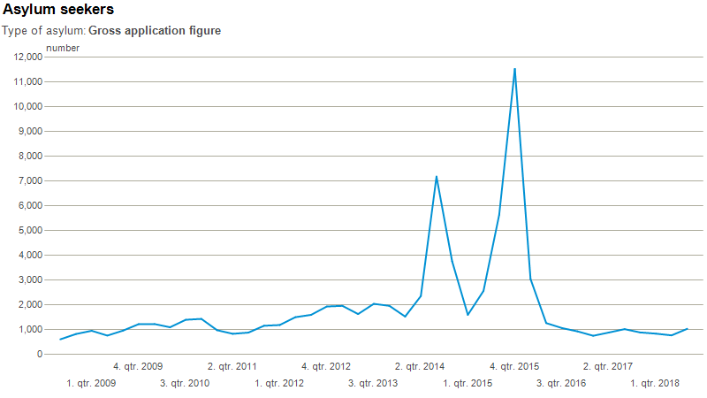
Immigrants and their descendants. (Statistics Denmark.). Retrieved January 6, 2019, from https://www.dst.dk/en/Statistik/emner/befolkning-og-valg/indvandrere-og-efterkommere

Slide 23
Immigration policies

Slide 24
Greece
first policies introduced in the late 1990s
estimated 1,820,000 migrants deported between 1991 and the first half of 1999 (Antonopoulos & Winterdyk, 2006)
Eurobarometer study (Kiprianos et al., 2003) from 1989 showed Greeks to be the most tolerant of immigrants in the EU
Balkan conflicts and recently the eurozone crisis were a negative influence on Greece’s openness to immigrants
migration is not an important issue in the Greek political scene

Slide 25
Absence of institutional policy
Despite large numbers of migrants there was a complete lack of institutional policy addressing immigration until the 1990s.
December 2009: new bill introduced by PASOK
It would facilitate naturalisation of first-generation immigrants and enable citizenship acquisition for immigrant children born in Greece.
February 2012:
Supreme court finds bill to be in violation of the constitution.
1998
2010
2009
2012
Some institutional arrangements introduced between 1998 and 2009
These policies were aiming to regulate issues of entry and legal residence of immigrants - ius sanguinis
March 2010:
The new bill (3838/10) is passed by PASOK and SYRIZA parties.
Own interpretation based on:
Figgou, L. (2016) Constructions of ‘Illegal’ Immigration and Entitlement to Citizenship: Debating an Immigration Law in Greece. J. Community Appl. Soc. Psychol., 26: 150–163. doi: 10.1002/casp.2242.

Slide 26
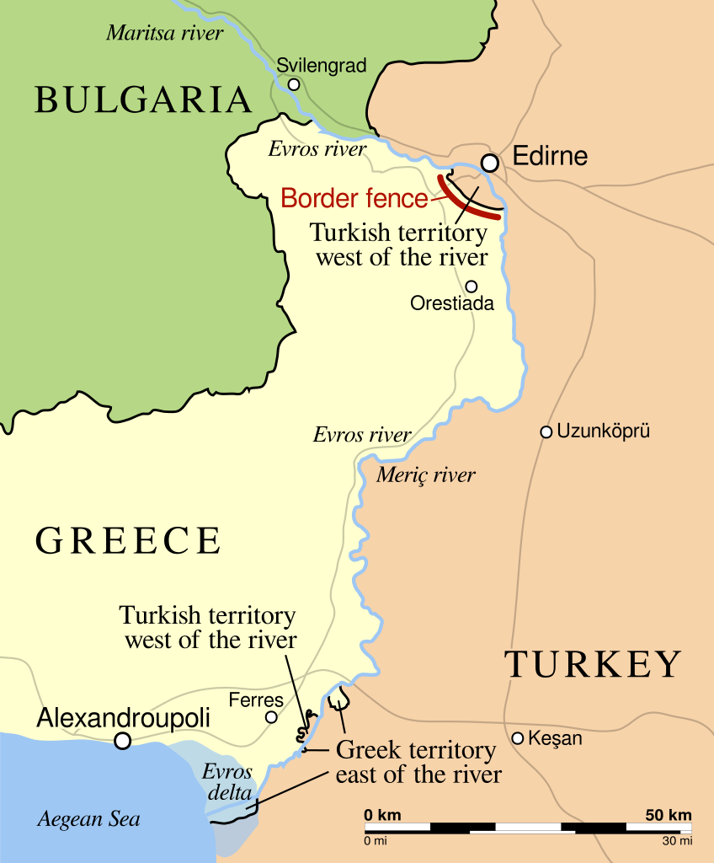
The border crossing near Edirne has been a contentious issue between Greece and Turkey due to high numbers of illegal border crossings in this area. This lead to a border fence being built along Turkish territory West of the Evros/Meriç river between October 2011 and December 2012. The border fence is 10,5 km long and cost 3 million euros to build. It lead to a significant reduction in illegal border crossings from Turkey to Greece.
P. (2015, November 19). The course of the Greece–Turkey land border, mostly following the Maritsa (Turkish: Meriç, Greek: Evros) river (depicted in blue), roughly indicating the 12.5 km border fence (in red) on the Greek side near Edirne, and major highways (in grey). [Map]. In Wikipedia. Retrieved January 4, 2019, from https://en.wikipedia.org/wiki/Border_barrier#Greece

Slide 27
Italy
first immigration law (Foschi Law) introduced in 1986
increased restrictiveness of immigration policy over time
one of the lowest naturalisation rates in Europe
continuity in reforms irrespective of the government's overall position
‘Salvini decree’ (2018) proposed further restrictions for asylum seekers, i.e. higher requirements for granting and easier revoking of asylum status
Paparusso, A., Fokkema, T., & Ambrosetti, E. (2017). Immigration policies in italy: Their impact on the lives of first-generation moroccan and egyptian migrants.Journal of International Migration and Integration, 18(2), 499-546. doi:http://dx.doi.org.eur.idm.oclc.org/10.1007/s12134-016-0485-x

Slide 28
Foschi Law
“Addressed non-EU workers only and aimed to prevent illegal immigration”
Turco-Napolitano Law
The law aimed to further restrict immigration by introducing worker quotas as well as detention centres. However, it also aimed to promote integration.
1990
2002
1986
1995
Martelli Law
The law now covered other motives of immigration apart from labour. Main aim was to restrict entry to foreigners.
Bossi-Fini Law
Further repressive policy towards illegal immigrants. Removal of sponsor system. Improvement of border control and police patrols.
Own interpretation based on:
Paparusso, A., Fokkema, T., & Ambrosetti, E. (2017). Immigration policies in italy: Their impact on the lives of first-generation moroccan and egyptian migrants.Journal of International Migration and Integration, 18(2), 499-546. doi:http://dx.doi.org.eur.idm.oclc.org/10.1007/s12134-016-0485-x

Slide 29
Denmark
increasingly restrictive policy since the early 1970s
issue of migration prevalent in national discussion (1990s to 2000s)
issues of integration and cultural identity in Denmark
increasing support for right-wing populist Dansk Folkeparti
integration a strong focus in recent years, i.e. efforts to integrate ghettos

Slide 30
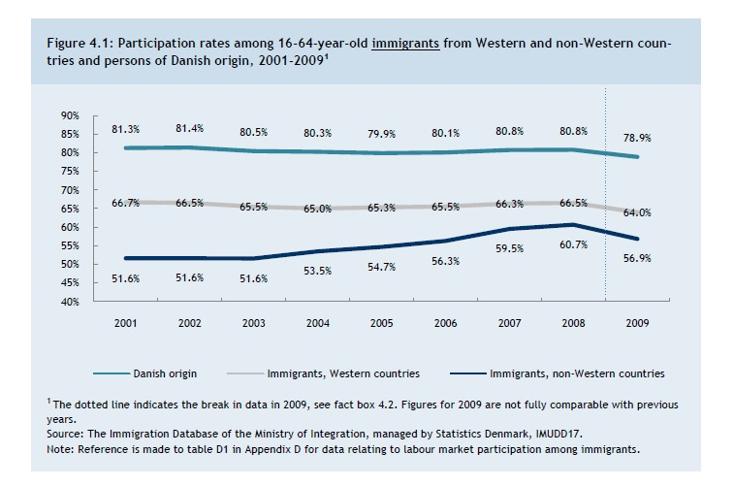
Danish Ministry of Refugees, Immigration, and Integration Affairs. (2010). Gaps in labor market participation between working age Danes, Immigrants of Western Origin, and Immigrants of Non-Western Origin from 2001 to 2008 [Chart]. In Statistical Overview of Integration: Population, Education, and Employment.

Slide 31
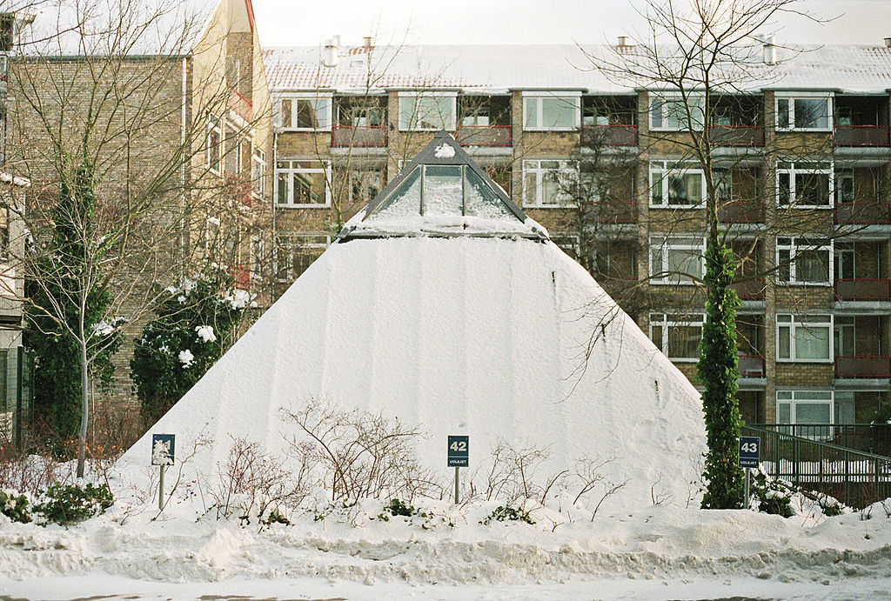
Photograph from a Danish ghetto neighbourhood Bispeparken in Copenhagen (left) and Dansk Folkeparti’s anti-censorship campaign from 2007 (right).

Slide 32
Comparison between Greece, Italy and Denmark

Slide 33
A welcoming Europe?
http://www.europarl.europa.eu/external/html/welcomingeurope/default_en.htm
https://data2.unhcr.org/en/situations/mediterranean

Slide 34
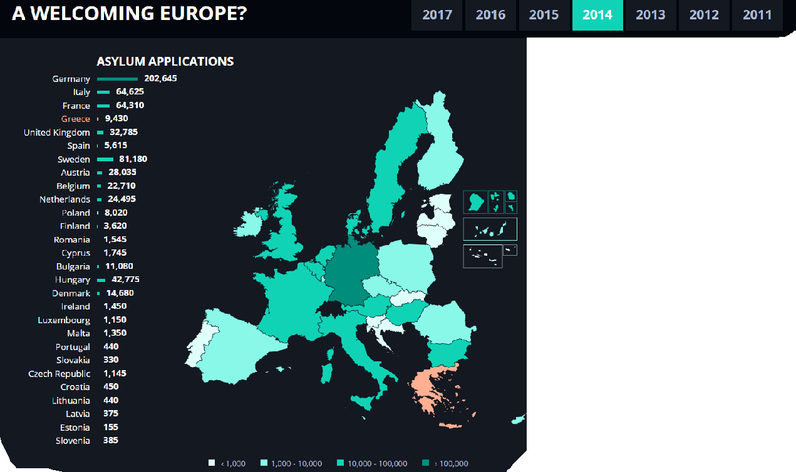
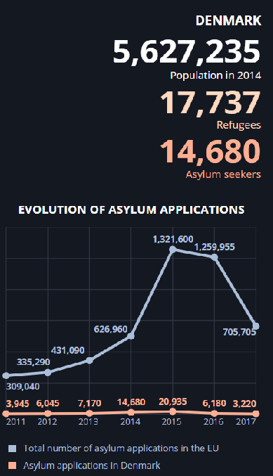
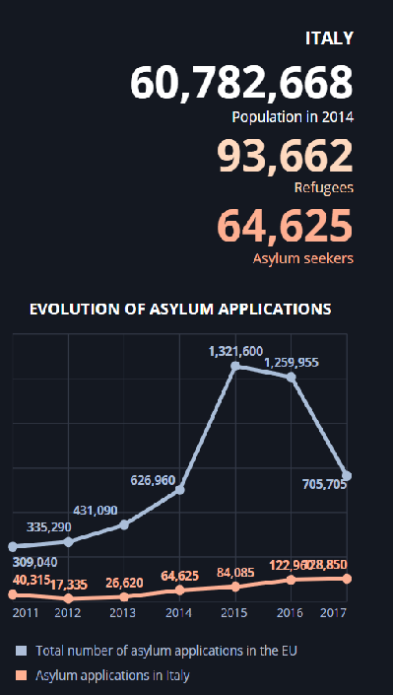
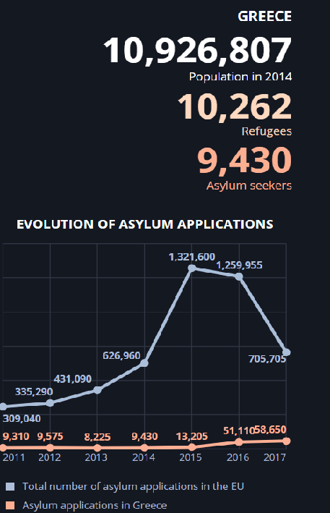
http://www.europarl.europa.eu/external/html/welcomingeurope/default_en.htm
Even for an arrival country, Greece got 9.430 asylum seekers and 10.262 refugees, it’s less than Denmark who got 14.680 asylum seekers and 17.737 refugees.
Italy is the most touched one by the immigration crisis in 2014 with 93.662 refugees and 64.625 Asylum seekers.

Slide 35
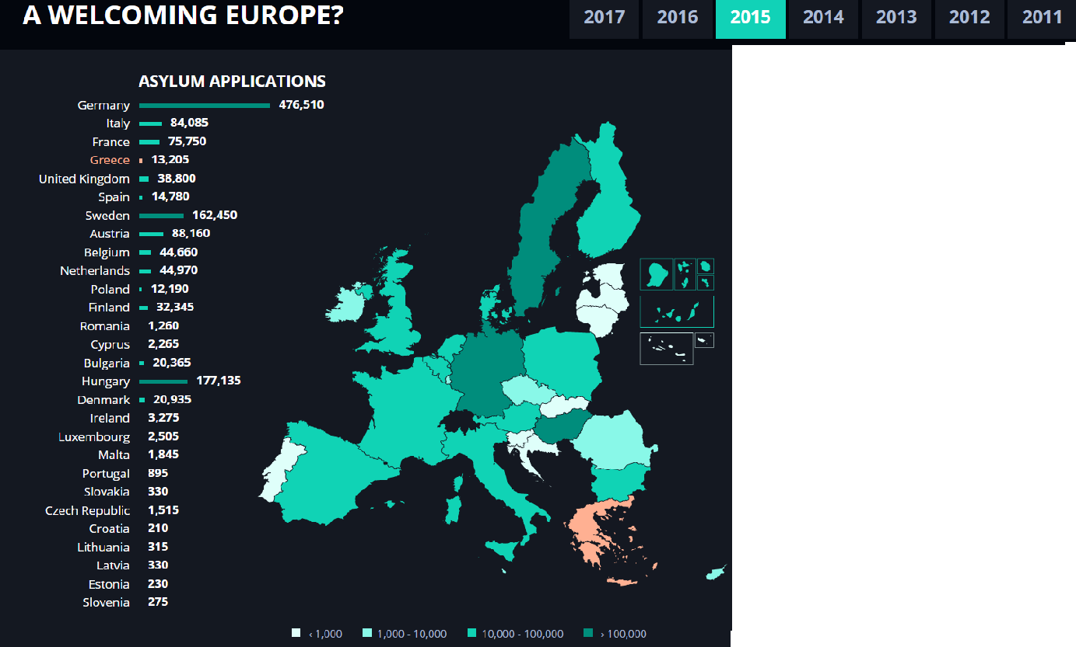
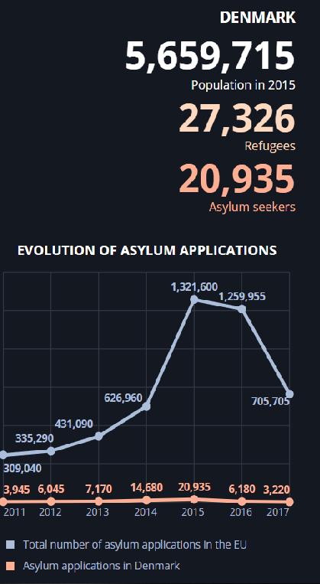
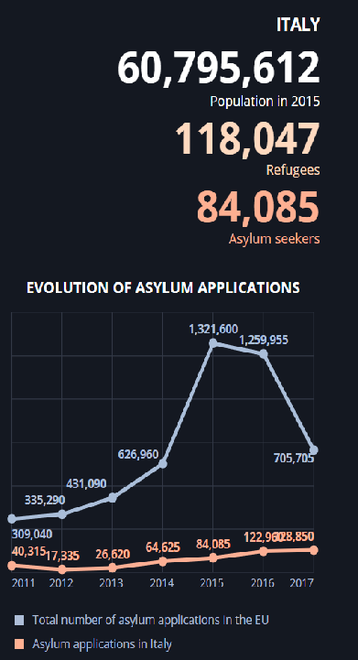
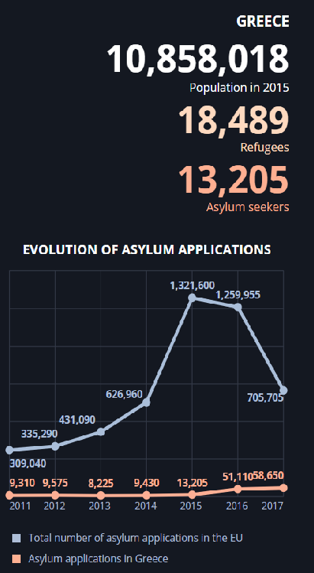
http://www.europarl.europa.eu/external/html/welcomingeurope/default_en.htm
2015 is the highest peak regarding the total number of asylum application in EU.
Gap between countries regarding refugees and asylum seekers didn’t really change in comparison with 2014.

Slide 36
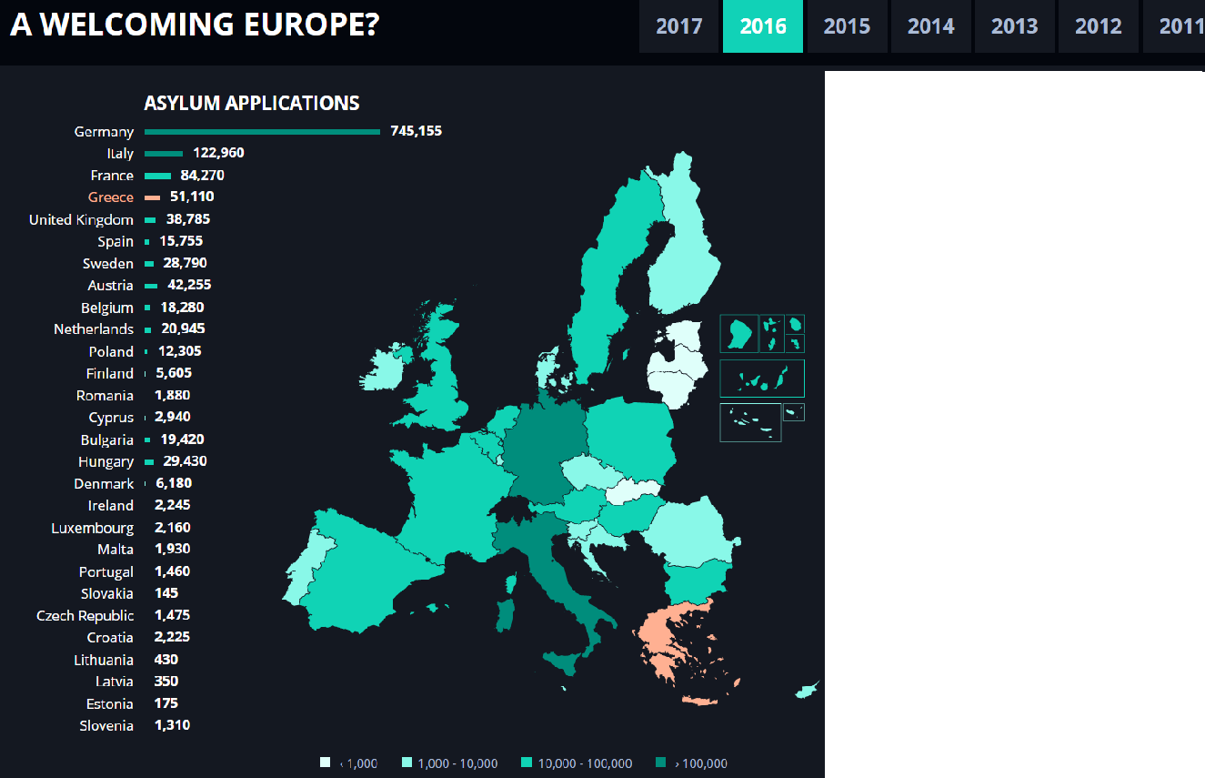
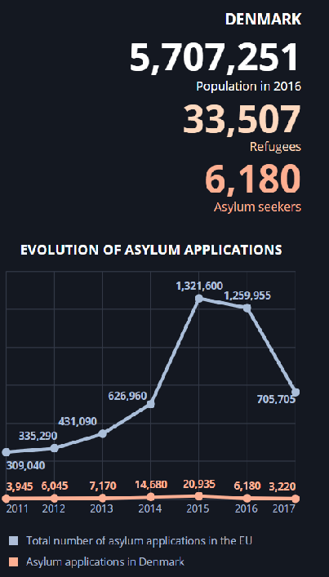
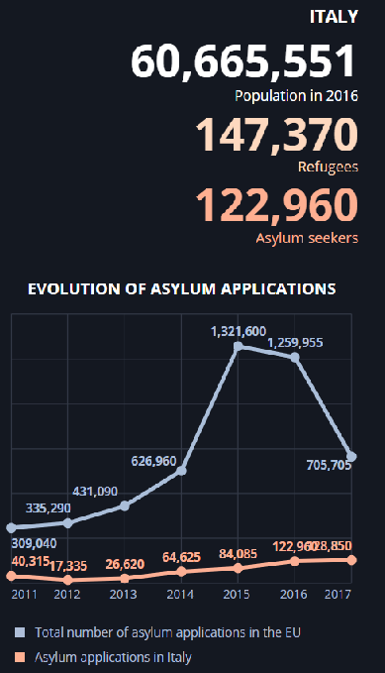
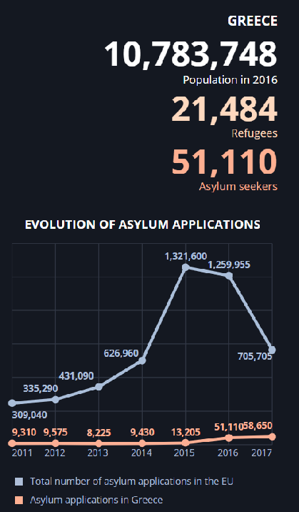
http://www.europarl.europa.eu/external/html/welcomingeurope/default_en.htm
Looking at the graph we can see that the total number of asylum application for EU stay really high.
In comparison with 2015, the number of asylum seeker for greece has been multiplied by almost 4. While this number decreased in Denmark.

Slide 37
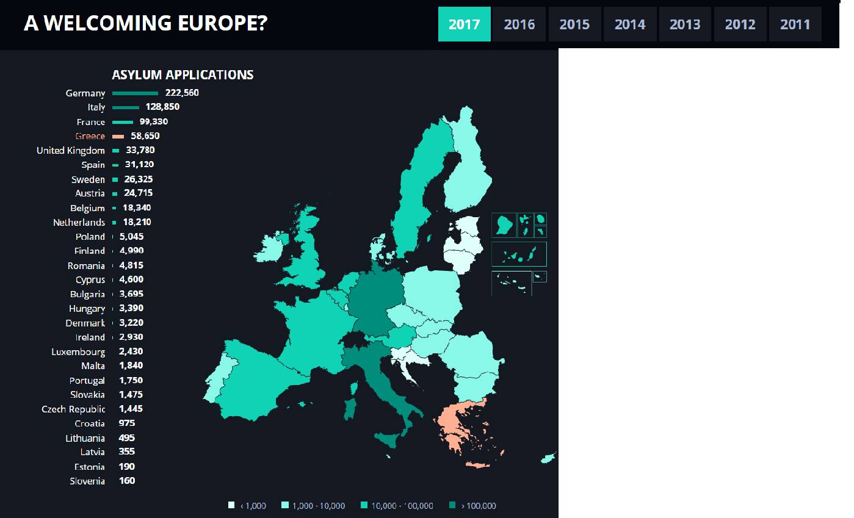
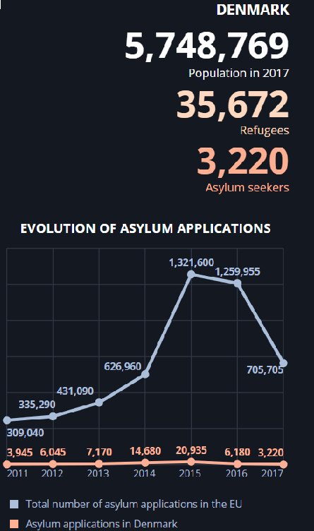
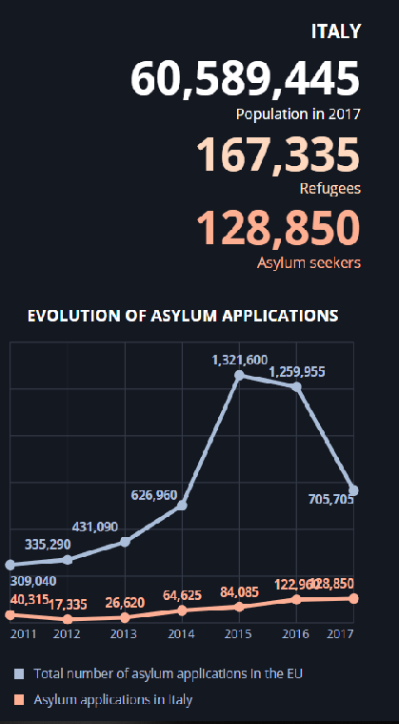
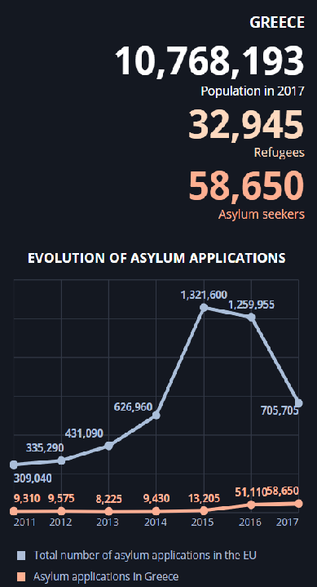
http://www.europarl.europa.eu/external/html/welcomingeurope/default_en.htm
In Italy and Greece the numbers are still growing while in Denmark only the number of refugees grew up, the number of asylum seekers there still decrease.

Slide 38
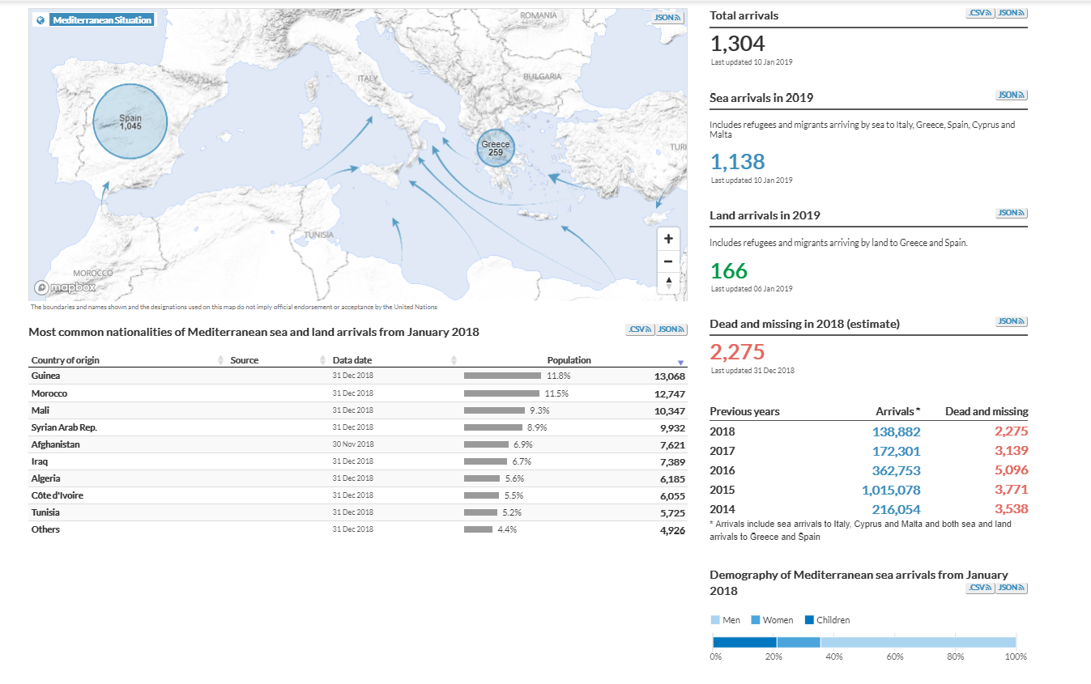
This document treat about sea arrivals in Italy, Cyprus and Malta and both sea and land arrivals to Greece and Spain
This is a document in continuous development, this image only treat about sea arrivals in 2019 and has been updated the 10 January of 2019. So I invite you to click on the link below to follow how it’s growing: https://data2.unhcr.org/en/situations/mediterranean
In 2018 they estimate the number of dead and missing by seas around 2.275 people. The lowest estimation since 2014.
https://data2.unhcr.org/en/situations/mediterranean
Retrieved the 13/01/2019

Slide 39
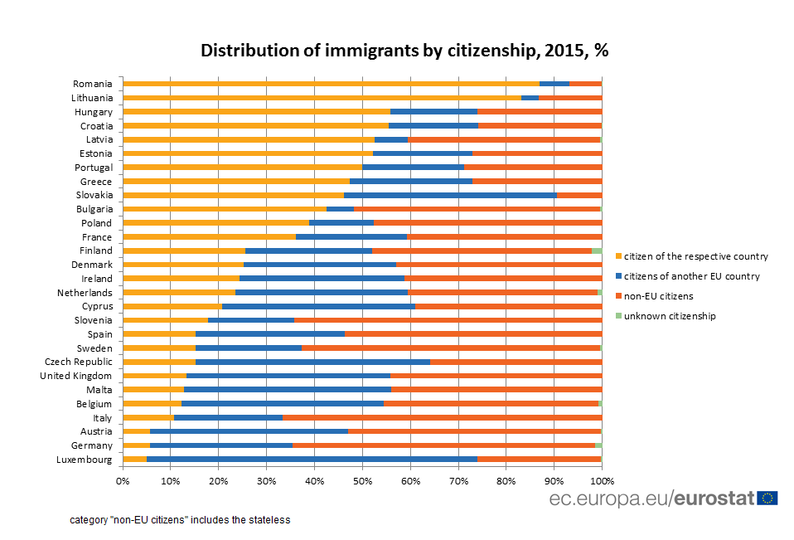
Percentage of greek people going back to Greece in 2015 rise almost 50% of total number of immigrants in Greece.
Greece get the lowest percentage regarding non-EU citizens immigrants in 2015. According to the previous document Denmark get more than Greece.
Italy get the highest percentage of non-EU citizens immigrants coming into borders in EUin 2015.

Slide 40
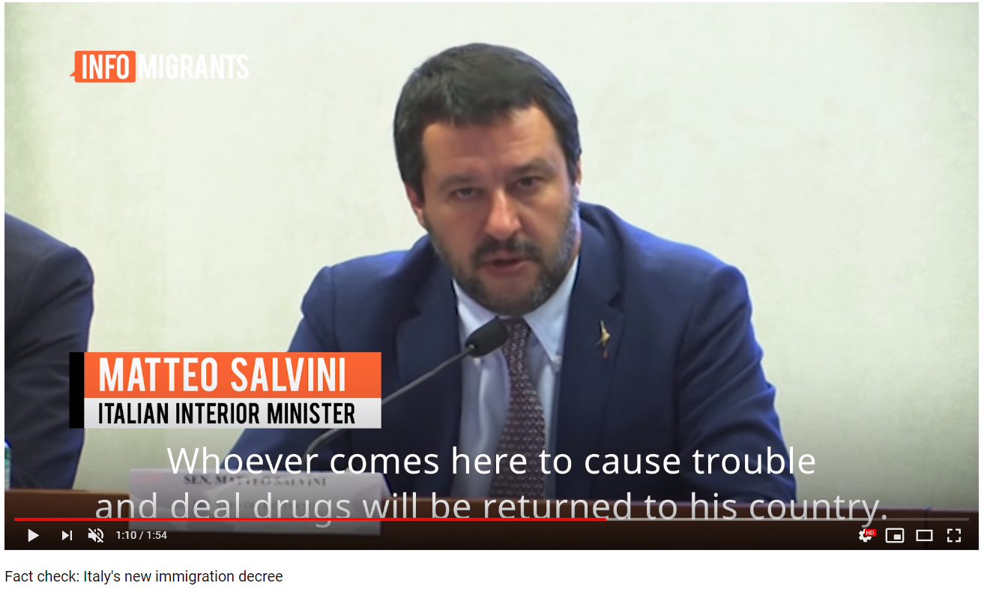
The difference about how immigrants are treated
In Denmark, government is trying to close ghettos in a strict way. https://www.youtube.com/watch?v=39ju-dpcJU0
In Greece and Italy there is too many immigrants looking for asylum, that’s why they’re talking about being stricter on borders and about who is admitted as an asylum seeker. https://www.youtube.com/watch?v=_OECe9crgxY Here the problem is that Matteo Salvini doesn’t give a real definition of “people who come here to cause trouble”, it’s too vague.

Slide 41
Possible issues for Europe

Slide 42
What has been put in place
EU opened safe pathways for relocating people from Greece and Italy in other EU member states, they opened a safe and legal way for asylum seekers to enter Europe like this they don’t have to risk their lives with smugglers.
Dublin Regulation is intended to admit immigrants as asylum seeker in the first country where they are controlled by authorities.

Slide 43
Problem encountered by EU
Some countries don’t want to accept migrants in their territory so they oppose the migrants quotas proposed by the EU to unclog arrival countries like Italy and Greece, for example the Visegrad group countries.
Dublin Regulation’s problem is that it violates the asylum seekers’ rights to travel to their intended destination. Also, it can lead to what happened in 2015 when Hungary was overburdened with asylum applications but had the obligation to process them in line with the agreement.

Slide 44
Conclusion
Greece and Italy are both sea arrivals countries with large number or refugees in 2015 and 2016
Denmark has been applying restrictive policy about immigrants really fast, since 1970.
The situation in Greece and Italy is getting worse with immigrants because they have to feed all of those migrants in a economic crisis situation.
Europe is trying to help border countries as it can but some european countries are against this tolerance about immigrants.
The Dublin Regulation is highly disadvantageous for border countries.
How to manage this crisis? Can we try to stop the problem at the source? Try to stop those war instead try to stop migrants? What will be the impact if one of the top five origins of refugees countries ends war, for example Syria?

Slide 45
References
Articles
Antonopoulos, Georgios A., and John Winterdyk. "The Smuggling of Migrants in Greece An Examination of its Social Organization." European Journal of Criminology 3.4 (2006): 439-461.
BBC. (2016). Migrant crisis: Hundreds cross from Greece into Macedonia. Retrieved January 3, 2019, from https://www.bbc.com/news/world-europe-35805010
Davies, L. (2014, June 25). Europe's migrant influx: 'we need help but we don't know where from'. Retrieved January 5, 2019, from https://www.theguardian.com/world/2014/jun/25/-sp-boat-migrants-risk-everything-for-a-new-life-in-europe
Figgou, L. (2016) Constructions of ‘Illegal’ Immigration and Entitlement to Citizenship: Debating an Immigration Law in Greece. J. Community Appl. Soc. Psychol., 26: 150–163. doi: 10.1002/casp.2242.
GREEN‐PEDERSEN, C. and KROGSTRUP, J. (2008), Immigration as a political issue in Denmark and Sweden. European Journal of Political Research, 47: 610-634. doi:10.1111/j.1475-6765.2008.00777.x
Kiprianos, Pandelis, Stathis Balias, and Vaggelis Passas. "Greek policy towards immigration and immigrants." Social Policy & Administration 37.2 (2003): 148–164

Slide 46
Maroukis T. (2012). Update report Greece: The number of irregular migrants in Greece at the end of 2010 and 2011. Database on Irregular Migration, June. Available at: http://irregularmigration.net/.
Paparusso, A., Fokkema, T., & Ambrosetti, E. (2017). Immigration policies in italy: Their impact on the lives of first-generation moroccan and egyptian migrants.Journal of International Migration and Integration, 18(2), 499-546. doi:http://dx.doi.org.eur.idm.oclc.org/10.1007/s12134-016-0485-x
Wadensjö, E. (2000). Immigration, the labour market, and public finances in Denmark. Swedish Economic Policy Reviw, 7, 59-83. Retrieved January 6, 2019, from https://www.government.se/reports/2000/01/swedish-economic-policy-review-volume-7-no.-2-the-assimilation-of-immigrants-in-the-labour-market-/
Databases
Immigrants and their descendants. (Statistics Denmark.). Retrieved January 6, 2019, from https://www.dst.dk/en/Statistik/emner/befolkning-og-valg/indvandrere-og-efterkommere
ISTAT. (2018.). Resident foreigners on 1st January - Citizenship. Retrieved January 5, 2019, from http://stra-dati.istat.it/Index.aspx
Istat, Population and Households. (2018, November 26). NON-EU CITIZENS: PRESENCE, NEW INFLOWS AND ACQUISITION OF CITIZENSHIP [Press release]. Retrieved January 5, 2019, from https://www.istat.it/en/archivio/224319
Danish Ministry of Refugees, Immigration, and Integration Affairs. (2010). Gaps in labor market participation between working age Danes, Immigrants of Western Origin, and Immigrants of Non-Western Origin from 2001 to 2008 [Chart]. In Statistical Overview of Integration: Population, Education, and Employment.

Slide 47
Other
Dörrbecker, M. (2015). European migrant crisis. Asylum applicants in Europe between 1 January and 30 June 2015 [Map]. Available at https://en.wikipedia.org/wiki/European_migrant_crisis, Retrieved 1 Jan 2019.
n.d (2015, November 19). The course of the Greece–Turkey land border, mostly following the Maritsa (Turkish: Meriç, Greek: Evros) river (depicted in blue), roughly indicating the 12.5 km border fence (in red) on the Greek side near Edirne, and major highways (in grey). [Map]. In Wikipedia. Retrieved January 4, 2019, from https://en.wikipedia.org/wiki/Border_barrier#Greece
States applying Dublin instruments [Map]. (2014, November 10). In Wikipedia. Retrieved January 5, 2019, from https://en.wikipedia.org/wiki/Dublin_Regulation
UNHCR data portal - Situations. Mediterranean Situation. Available at https://data2.unhcr.org/en/situations/mediterranean. Retrieved 1 Jan 2019.
https://www.easo.europa.eu/about-us/what-we-do
http://www.europarl.europa.eu/portal/en

