Slide 1
The EU facing the migrant and refugee crises 2014+: the case study of Germany & Poland
A presentation by
Witold Patryk Jakub Gańko (Szkoła Główna Handlowa w Warszawie)
Janis Wiegand (Christian-Albrechts-Universität zu Kiel)
Janek Mücksch (Hochschule für Wirtschaft und Recht Berlin)
in the course Europe and international migration: an interdisciplinary perspective

Slide 2
Agenda
1. Intodruction
2. Data about refugees
2.1. European data on refugee movements
2.2. German data on refugee movements
2.3. Polish data on refugee movements
3. The migrant and refugee situation in Poland and Germany since 2014
3.1 Governments' response
3.1.1 Migration policy of both countries
3.1.2 Supply of accommodations for refugees
3.1.3 Education and consultation offers for refugees
3.1.4 Labour market policy

Slide 3
Agenda
3.2 Media response
3.2.1 TV debates
3.2.2 Print media
3.2.3 German media facing a "trust crisis"
3.2.4 Xenophobic riots in Ełk
3.3 Societies' response
4. Summary
Sources

Slide 4
1. Intodruction

Slide 5
2.1. European data on refugee movement
Source: http://ec.europa.eu/eurostat/statistics-explained/index.php/Asylum_statistics, Acess at 03/01/2017.

Slide 9
Current situation in the EU (2016)
Between January and November 2016: c.a. 1.2 million applications for international protection (EASO 2016)
-6% comparing with 2015
Syria and Afghanistan were the two countries with the most applicants, Nigeria raised on the 3rd rank
Numbers of illegal boarder crossing shrinks on the eastern Mediterranean route
The central Mediterranean route is the new main route of entry to the EU (FRONTEX 2016)

Slide 10
2.2. Data of the refugee and migration crisis in Germany (2014-2016)
Graph is showing the different figures of refugee movement to Germany from January 2014 until May 2016 on monthly data base.
Bright blue columns were showing the registration into the German EASY-system for relocation in the German ferderal states
The dark blue columns were showing the number of asylum applications
Source:http://charts.bpb.de/OXTku/m.png. Acess at 03/01/2017

Slide 11
Current situation in Germany (2016)
Government assumes about 890.000 seakers for international protection entered the country during 2015 (Ferderal Ministry of the Interior 2016)
Between January and November 2016 c.a. 702.000 new applications for international protection (79.2% rise in comparison with 2015)
Important Nationalities of applicants: Syrians, Afghani, Iraqis (Ferderal Office for Migration and Refugees 2016)
Registered movements in the first 11 months of 2016: c.a. 303.000 people (Ferderal Ministry of the Interior 2016)

Slide 12
2.3. Data of the refugee and migration crisis in Poland (2014-2015)

Slide 16
Internationional Protection
In 2014 and 2015:
318 out of 491 Syrians (64%) were granted refugee status
Only 1 Syrian application from was rejected.
Most rejected applications were from Russia and Ukraine.
Source: http://udsc.gov.pl/

Slide 17
Ukraine
According to the Office for Foreigners nearly 31% of foreigners in Poland are Ukrainians.
In 2014 more than 233 000 Ukrainian migrants was registered in Poland and nearly 0,5 million temporary work permits have been granted.

Slide 18
3.1.1 Migration policy of both countries
Governments' response in Germany
Participation in the UNHCR refugee resettlement program
Acceptance of a large number of Syrian refugees
Migration law is getting more conservative
2014/2015: Serbia, Bosnia, Macedonia, Albania, Montenegro, Kosovo are considered as safe third-countries
2016: Tunisia, Morocco, Algeria became safe third-countries
December 2016: Deportation to Afghanistan
Temporary abolishment of family reunification

Slide 19
3.1.1 Migration policy of both countries
Governments' response in Poland
Former government of center-right Civic Platform decided to accept 7 000 refuges in EU relocation program
New radical right wing government refuse to accept ANY refugee

Slide 20
Polish Card
A document confirming belonging to the Polish nation.
It was established by an act of the Polish parliament in 2007
A holder of the “Karta Polaka” has the right to:
exemption from the obligation to have a work permit for foreigners;
set up a company on the same basis as citizens of Poland;
study, do a doctorate and participate in the other forms of education, as well as participate in research and development work. The holder retains the right to apply for scholarships and other forms of aid for foreigners;
preschool, primary and secondary education in Poland;
use of health care services in the states of emergency;
37% discount on public transport omnibus, flier and express rail travel;
free admission to state museums.

Slide 21
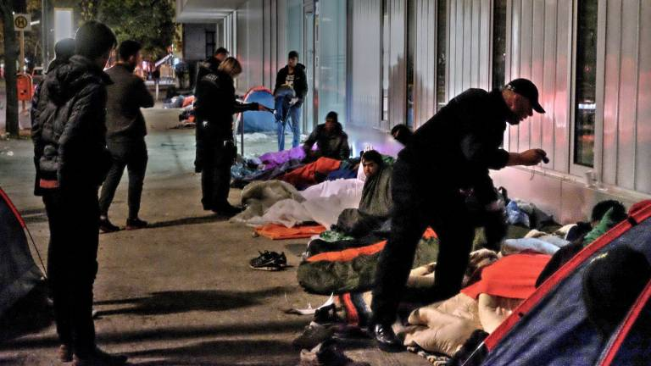
3.1.2 Supply of accommodations for refugees
Governments' response in Germany
Container, empty buildings, gyms, tents, ho(s)tels, flats
Mostly mass accommodations (conflicts inside the accommodation)
Actually maximum duration of
stay in mass accommodation: three months
-> change to six months
Quality of supply depends
on federal state
-> sometimes lack of accommodations
People sleeping on the street due to the lack of refugee accommodations in Berlin. Source: bz.de

Slide 22
3.1.2 Supply of accommodations for refugees
Governments' response in Poland
Poland has 11 state refugee centers
1653 people live in refugee centers
According to Ministry of Justice there was a plan to accommodate former soviet military bases to temporary refugee camps.

Slide 23
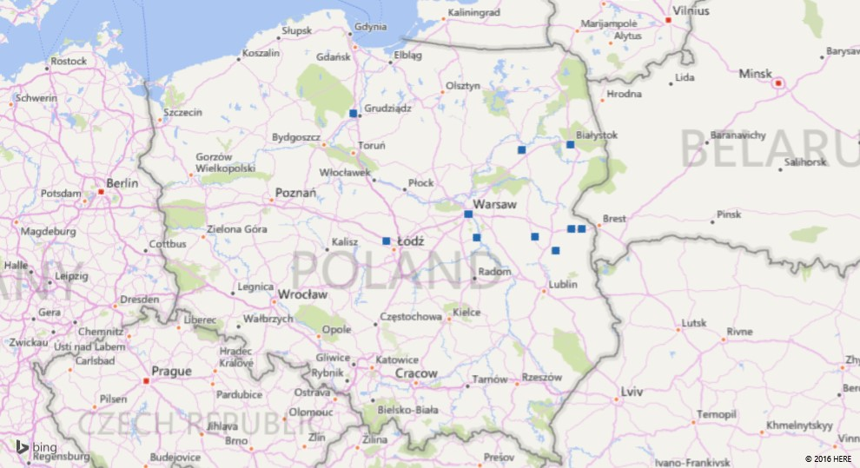

Slide 24
3.1.3 Education offers for refugees
Governments' response in Germany
Syrian refugees are below average educated: 16% illiterates, 20% high level of education
Increase of obligatory "orientation lectures" (2016)
Lack of German teachers (lectures often held by volunteers)
Suggestion: just language courses for accepted refugees
Underage migrants shall go to regular schools after one year

Slide 25
3.1.4 Labour market policy
Governments' response in Germany
First three months: No opportunity to work
Next 15 months: Oportunity to work but: employer has to prove that no German with same qualifications applied for the job
abolishment of that rule in regions with a low unemployment for three years
Estimation: 100.000 refugees work illegally

Slide 26
3.2.1 TV debates
Commonly shared view: the anti-immigrant party AfD was over represented in talk-shows during the refugee and migration crisis, which supported its rise in the polls
Observation: AfD members did not participate often in observed TV debates (Anne Will: 2/10; Hart aber Fair: 0/6; Mennschen bei Meischberger: 2/7)
Conclusion: The aim of controverse opinions did not lead to a over representation of the party AfD in TV debates. This spectrum of opinion was represented by members of the German conservative parties or by guests from other European countries.

Slide 27
3.2.1 TV debates

Slide 28
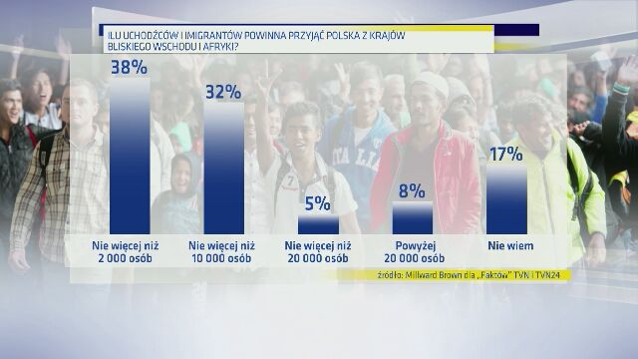

Slide 29
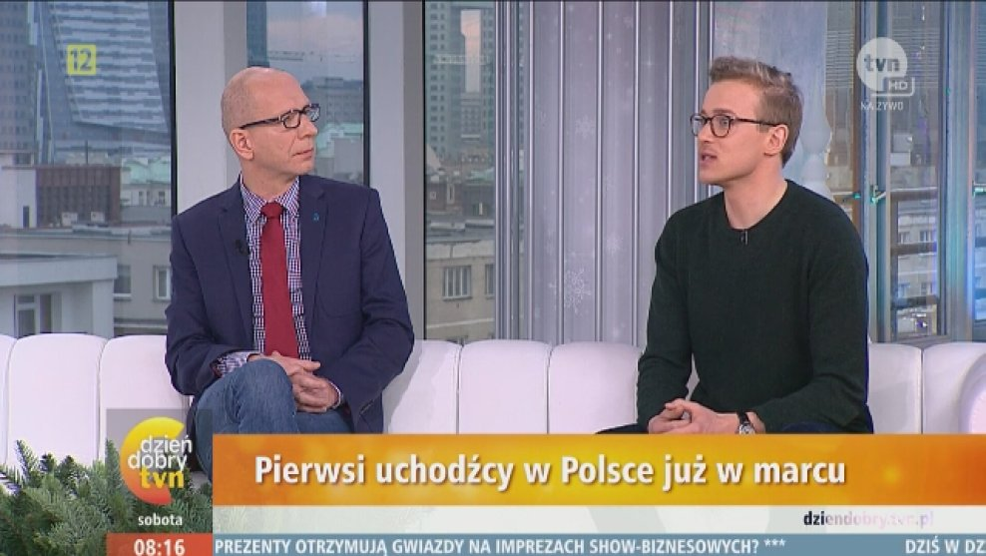

Slide 30
3.2.2. Print media
Study 'Meinungsflut und Flüchtlingsstrom' about the treatment of the migration and refugee crisis in the German press.
Scope: Analysis of over 30,000 articles from more than 100 newspapers and several online publications (2009-2015)
Result: 82% positive, 12% neutral, 6% negative
66% of the newspapers did not mention problems of the society
In most articles the focus lay on the political and institutional stage (75% of mentioned people) only 5% of mentioned people were volunteers, 3% refugees

Slide 31
Phase 0
Begin of 2015: reporting on refugees manly relied on stereotypes (refugees in a crowd; economic migration)
The catastrophe of Lampedusa increased the critics on the European policy
Critics on the reporting: the point of view from refugees was not covered by the reporting; drama sells

Slide 32
Phase I - euphoria

Slide 33
Phase I – euphoria [July-October]
Main aspect of reporting: humanity
Journalists were loosing the critical distance towards refugees – no coverage of social problems related to the huge inflow of refugees
Opposing against critics of refugee policy
--------------------------------------------
"Selfie of the society"; Motto: "We Germans are living a friendly and open welcoming culture and help needy people – We are great"
Social issues and critics were overlooked
Tensions between the published and experienced reality of the people

Slide 34
Campaign: Refugees Welcome
During the refugee crisis the German tabloid newspaper 'Bild' started the campaign "we help- refugees welcome"
Newspaper said it wants to stand to its values
Critics said: cheap advertisement

Slide 35
Phase II - turning point

Slide 36
Phase II - turning point [October-December]
After the introduction of border controls on the Austrian border
Swing to the other extreme: extreme projections of future refugee movement were published (e.g. Bild: up to 1.5 million refugees)
Reaction on the critics of reporting -> a new ideal of the neutral journalists raised
---------------------------------------------
"With the refugees arriving problems appeared"
Media went after the public opinion -> tried to close the gap
The media covered only the political dispute and overlooked the social conflicts

Slide 37
Phase III - turnaround

Slide 38
Phase III – turnaround [january - ]
Newspapers were still using stereotypes (e.g. debate about 'the Arab men' after the incidents in Cologne)
Reference to the moral authority of the basic law – teaching of the people
No deep digging into the integration issue (simplifying view on it)
Main focus on the problems of integration
Danger of flipping into the other extreme

Slide 39
Critics from the media
The monthly magazine "Cicero" opposed the refugee policy of the government from the beginning
The magazine was criticised for its one-sided view, as well as, for the reproduction of populisitic phases and images on its front pages

Slide 40
3.2.2. Print media in Poland

Slide 41
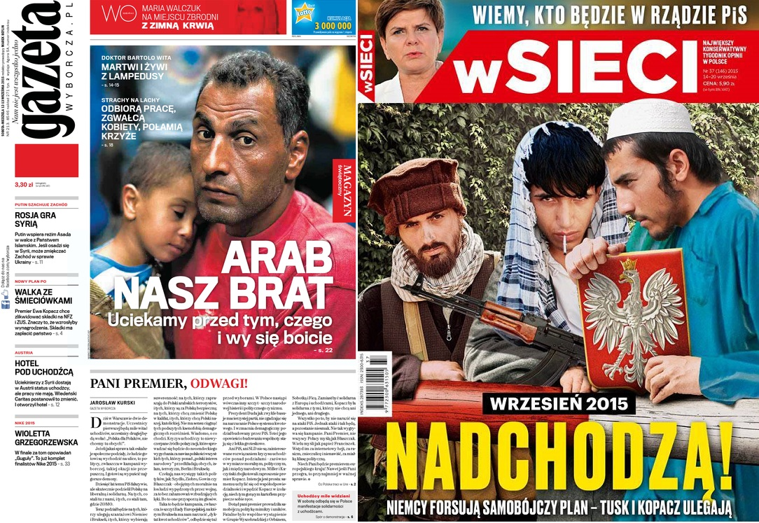

Slide 42
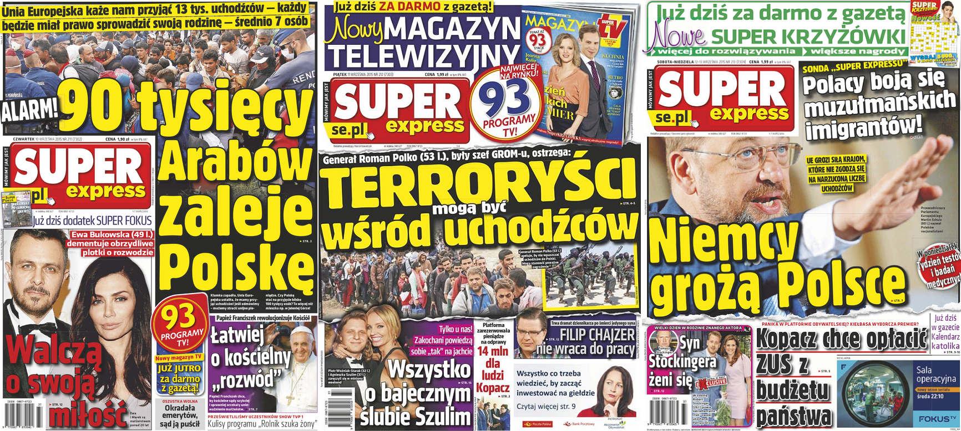

Slide 43
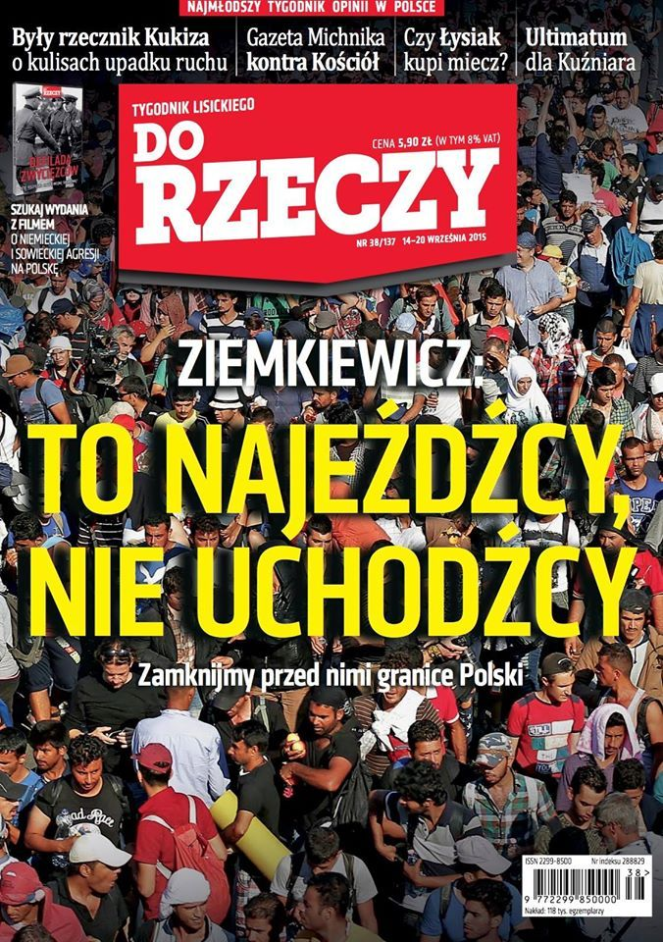

Slide 44
3.2.3. German media facing the trust crisis
Journalists were more often confronted with rejection and hate in Germany
Polls were showing only 40% trust or trust strongly the media
The media is reporting its "trust crisis"
Researchers do not see any evidence for it in the long run (hypothesis: trust is related to current issues)

Slide 45
3.2.3. German media facing the trust crisis
Poll of the German institute Allensbach (December 2015):
81% were confident with the quality of the media
64% found the media reports reliable
-> number increased over the last six years
39% agreed to some extent to the term 'Lügenpresse'
Critics about the reporting on the refugee crisis:
-> 51% were not confident with it; 41% think that the reports were one-sided; 41% were convinced that critics were ignored; 53% think that the media did not draw a coherent picture of the composition of the refugee movement

Slide 46
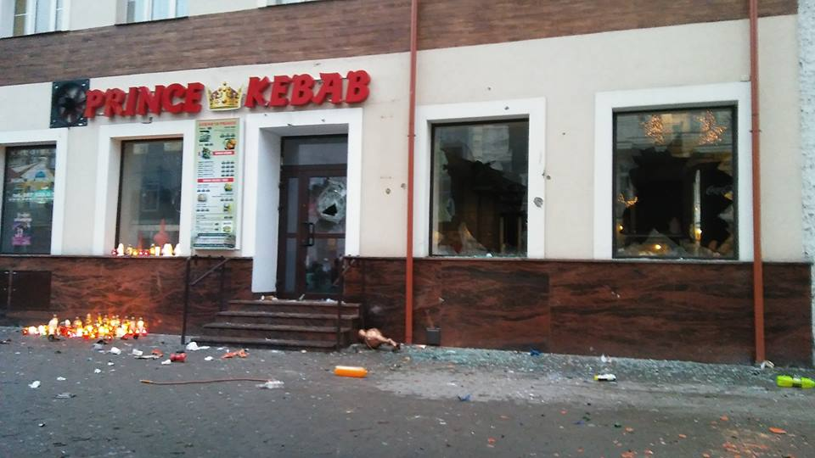
Xenophobic riots in Ełk

Slide 48
3.3. Societies’ response
Societies’ response in Germany
~50% opposing refugee policy; 50% support
6% get voluntary involved
Decrease in satisfaction with the federal government
Strong increase regarding xenophobic violence

Slide 50
3.3. Societies’ response
Societies’ response in Poland
Most poles opposing EU refugee policy
Strong increase regarding xenophobic violence
Poles are more open to Eastern European migration

Slide 51
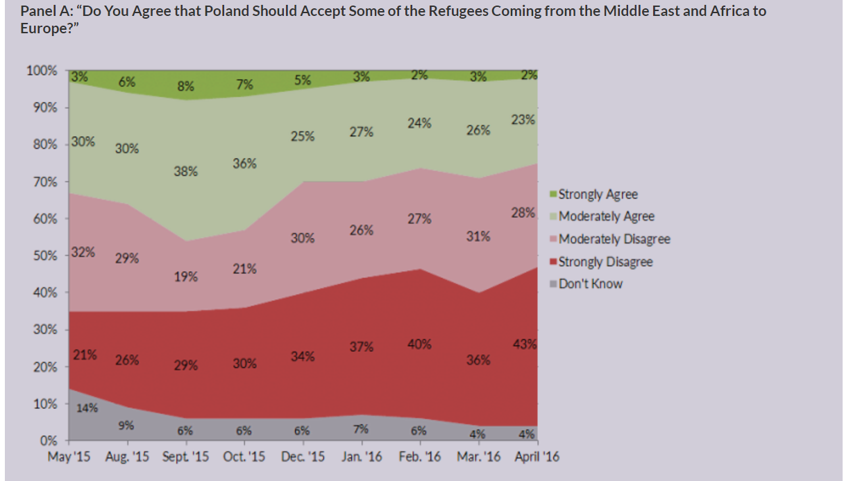

Slide 52
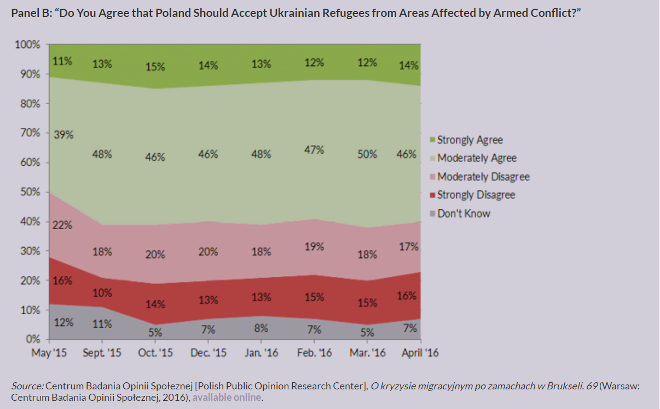

Slide 53
Sources
Decker, Oliver; Kiess, Johannes; Brähler, Elmar: Die enthemmte Mitte. Autoritäre und rechtsextreme Einstellung in Deutschland. Psychosozial-Verlag, Gießen 2016.
FAZ (2016): Afghanische Flüchtlinge. Wie Sammelabschiebungen zu Einzelfällen werden. Online: faz.net, access at 21/12/2016.
Infratest dimap (2015): 54 Prozent der Bevölkerung meinen: Wir schaffen es nicht, die Flüchtlinge erfolgreich zu integrieren. Online: infratest-dimap.de, access at 29/11/2016.
Infratest dimap (2016): ARD-DeutschlandTREND September 2016. Eine Studie im Auftrag der Tagesthemen. Online: infratest-dimap.de, access at 29/11/2016.
Konle-Seidl, Regina; Bolits, Georg (2016): Labour Market Integration of Refugees: Strategies and good practices. Directorate General For Internal Policies. Policy Department A: Economic And Scientific Policy, 2016-08, Brussels 58p.
NDR (2015): Die Einstufung als "sicheres Herkunftsland". Online: web.archive.org, access at 21/12/2016.
Ostrand, Nicole (2015) The Syrian refugee crisis: a comparison of responses by Germany, Sweden, the United Kingdom, and the United States. Journal on Migration and Human Security, 3 (3). pp. 255-279.
Spiegel (2016a): Flüchtlingspolitik. Große Koalition einigt sich auf neues Asylpaket. Online: spiegel.de, access at 21/12//2016.
Spiegel (2016b): Umfrage. Große Mehrheit fordert Korrektur der Flüchtlingspolitik. Online: spiegel.de, access at 29/11/2016.
Stern (2016): News zur Landtagswahl in Mecklenburg-Vorpommern. AfD holt drei Direktmandate. Online: stern.de, access at 29/11/2016.
Weber, Enzo; Weigand, Roland (2016): Identifying macroeconomic effects of refugee migration to Germany. (IAB-Discussion Paper, 20/2016), Nürnberg, 15 p.
Zeit (2016). Rechte Gewalt. BKA zählt 665 Straftaten gegen Asylbewerberunterkünfte. Online: zeit.de, access at 29/11/2016.

Slide 54
Sources
The Office for Foreigners Online: http://udsc.gov.pl/
CBOS (2016): Stosunek Polaków do przyjmowania uchodźców Online: http://www.cbos.pl/
TVN (2016) “Polacy są niechętni wobec uchodźców?” Online: http://dziendobry.tvn.pl/
Polityka (2016): Niewidzialni. „Milion Ukraińców w Polsce: Kim są? Gdzie pracują?” Online: http://www.polityka.pl/
SuperBiz.pl (2016): Polska to raj dla pracowników z Ukrainy. Ilu imigrantów przyjęliśmy? Online: http://superbiz.se.pl/
Kultura Liberalna (2016): Uchodźcy w mediach – walka o klienta. Online: http://kulturaliberalna.pl/
Migration Policy Institute (2016): Diminishing Solidarity: Polish Attitudes toward the European Migration and Refugee Crisis Online: http://www.migrationpolicy.org/

Slide 55
Sources
ARD.de: archive of TV debates, Online: ard.de, acess at 21/12/2016.
BAMF (2016): Aktuelle Zahlen zu Asyl (11/2016). Online: http://www.bamf.de/SharedDocs/Anlagen/DE/Downloads/Infothek/Statistik/Asyl/aktuelle-zahlen-zu-asyl-november-2016.html?nn=7952222, acess at: 03/01/2017.
EASO (2016): Latest asylum trends – November 2016. Online: https://www.easo.europa.eu/latest-asylum-trends, acess at 03/01/2017.
Eurostat (2016): Asylum statistics. Onilne: http://ec.europa.eu/eurostat/statistics-explained/index.php/Asylum_statistics, acess at: 03/01/2017.
Ferderal Agency for Civic Education (2016): Zahlen zu Asyl in Deutschland. Infografiken des Bundesamtes für Migration und Flüchtlinge. Online: http://www.bpb.de/politik/innenpolitik/flucht/218788/zahlen-zu-asyl-in-deutschland, acess at 03/01/2017.
FAZ (2016b): Mehrheit fühlt sich über Flüchtlinge einseitig informiert. Online: http://www.faz.net/aktuell/politik/fluechtlingskrise/allensbach-umfrage-zu-medienberichterstattung-in-fluechtlingskrise-13967959.html?printPagedArticle=true#pageIndex_2, acess at 03/01/2017.
FES (2016): Studie zeigt Stabilität rechtsextremer und popululistischer Einstellungen . Online: https://www.fes.de/de/gespaltene-mitte-rechtsextreme-einstellungen-2016, acess at 03/01/2017

Slide 56
Soures
Frontex (2016): Frontex risk analysis network quarterly report 2/2016. Online: http://frontex.europa.eu/publications/?c=risk-analysis, acess at 03/01/2017.
Haller, Michael (2016): Reporting on refugees in the field of tension between human rights and social compatibility; public lecture at the University of Hamburg on 28/11/2016. Online: https://www.youtube.com/watch?v=wm04hYRXIzE&feature=youtu.be, acess at 21/12/2016.
Hemmelmann, Petra; Wegner, Susanne (2016): Flüchtlingsdebatte im Spiegel von Medien und Parteien. At: Communicatio Socialis, 1/2016.
Süddeutsche (2016): Wie groß ist der Vertrauensverlust in die Medien wirklich? Online: http://www.sueddeutsche.de/medien/medienkritik-wie-gross-ist-der-vertrauensverlust-in-die-medien-wirklich-1.2858608, acess at 03/01/2017.
TAZ (2016): Vielvölkerstaat Deutschland. Online: http://www.taz.de/!5270843/, acess at 03/01/2017.
Zapp (2014). Online: https://www.ndr.de/fernsehen/sendungen/zapp/ZAPP-Studie-Vertrauen-in-Medien-gesunken,medienkritik100.html, acsess at 03/01/2017.
Archives of selected German press publications: 'Der Spiegel'. Online: http://www.spiegel.de/spiegel/print/index-2017.html, acess on: 03/01/2017.; 'Die Zeit'. Online: http://www.zeit.de/2016/index, acess on: 03/01/2017.;'Ciceo'. Online: http://shop.cicero.de/einzelhefte/, acess on: 03/01/2017.

