Slide 1
“Take back control of our borders” The role of immigration in the Brexit debate
Simon Goodman
Research Fellow, Coventry University

Slide 2
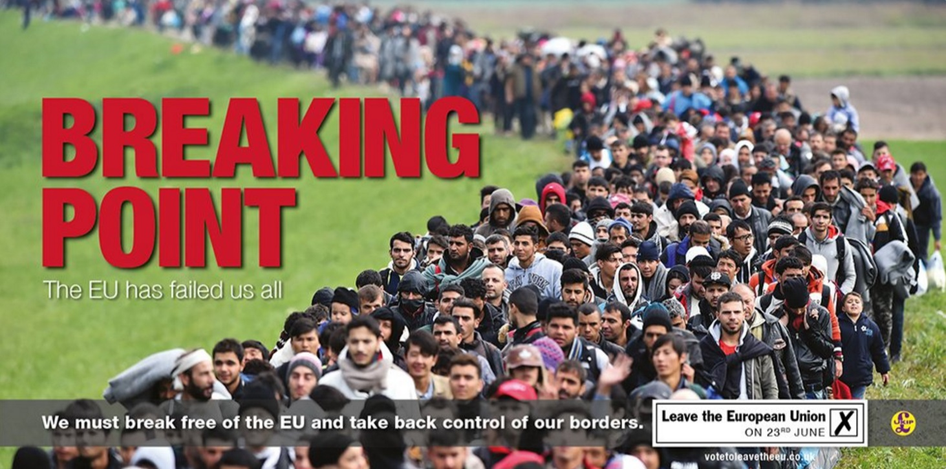
Background
Brexit
Immigration key issue in debate
Coincided with “refugee crisis”
Leave campaign focussed on stopping migration
Hostility to migration

Slide 3
Research question
How did participants in the Brexit debate talk about immigration?
What did this talk accomplish?

Slide 4
Method
Discourse analysis
Focus on what talk accomplishes
Data: Trawl of UK media outlets

Slide 5
Overview of Findings
Leave campaigners presented immigration as out of control
Remain campaigners presented Brexit as an ineffective way of controlling migration
(In limited cases) Immigration was presented as beneficial

Slide 6
Immigration “out of control”

Slide 7
Analysis
Threat: 26m jobseekers, 76m potentially from Turkey
Lack of control: therefore leave EU to “take back control”
This was a key slogan
Economic argument
However references to immigration from outside EU,
Including refugees

Slide 8
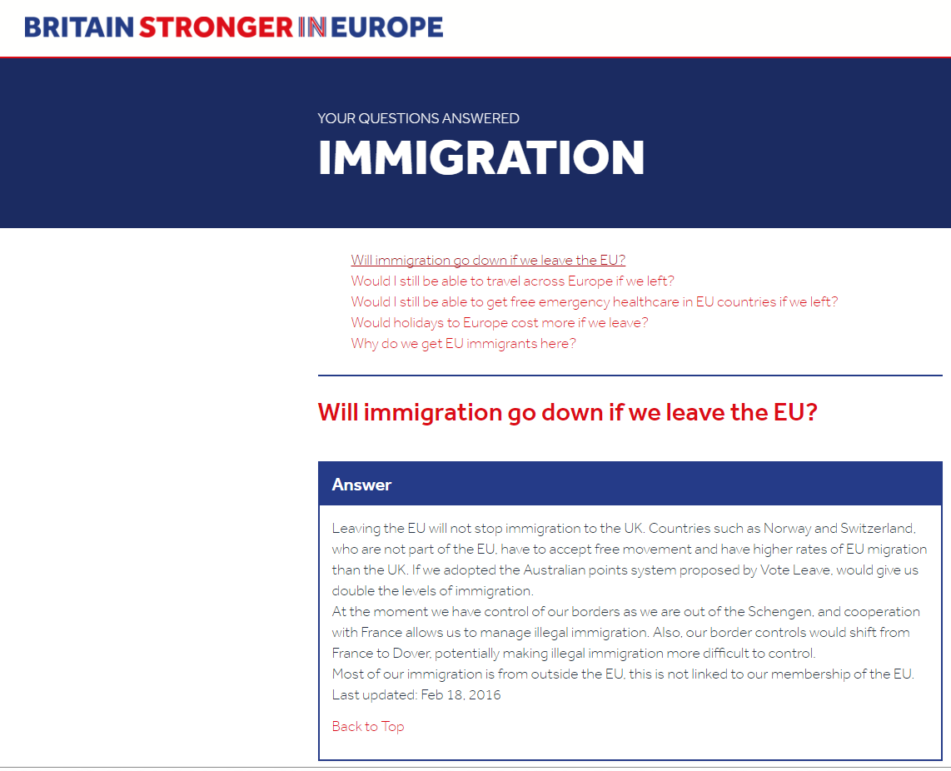
Brexit as an ineffective way of controlling migration

Slide 9
Analysis
Brexit presented as poor way to control immigration
i.e. immigration will continue despite Brexit
Would not make much difference
Would not mean big drop
This doesn’t mean that immigration is good
Just that Brexit won’t stop it

Slide 10
Immigration beneficial
Rare argument
Points to economic advantages of migration
i.e. migrants contribute more than they cost
Sign of a good economy
This contradicts ‘lack of control’ argument

Slide 11
Discussion
Leave: Lack of ‘control’ main argument
With ‘risk’ of new migration and refugees implied
Remain: Brexit doesn’t offer control
Counters leave’s claim, not problematising of migration
Genuine counter argument (immigration good) rare
Focus on immigration appears to have been major factor in success of the ‘vote leave’ campaign

Slide 12
Implications
Opposition to immigration has become mainstream and largely unproblematic
It’s supporting immigration that is the problem
It remains to be seen what impact Brexit will have on immigration
Early figures suggest a ‘self selecting’ reduction
Campaign based on fear of others has been successful

Slide 13
Contact
Dr Simon Goodman
Centre for Innovative Research Across the Life Course, Coventry University, UK
Simon.Goodman@coventry.ac.uk
+44(0)2477659515
Twitter: @DrSimonGoodman

