Slide 1
Migration crisis and its impact on Polish integration policy
Dominik Wach
Centre of Migration Research, University of Warsaw
Warsaw Family Support Centre

Slide 2
The aim of the presentation is to show the relationship between the migration crisis and Polish integration policy.
Questions:
How has the evolution of the Polish integration policy looked like since 1990s?
Have we observed the recent migration crisis in Poland?
How has the new migration situation in Europe affected Polish integration policy?

Slide 3
Periods of the evolution of Polish integration policy
1st period – 1989-2000
2nd period – 2000-2008
3rd period – 2008-2015
4th period – 2015+
1989-2000
2000-2008
2008-2015
2015+

Slide 4
1989-2000
Problems with political transformation.
Lack of the general awareness of the problem and long term integration actions.
Sporadic integration initiatives undertaken ad hoc and in response to current problems.
Integration (or rather humanitarian) initiatives on NGOs’ shoulders.

Slide 5
2000-2008
Emergence of Individual Integration Programs – first sustainable element of integration policy (only foreigners who were granted refugee status could benefit).
European Funds (EQUAL Community Initiative Programme, ERF – European Refugee Fund) as a main source of financing other forms of integration initiatives.

Slide 6
2008-2015
Development of Individual Integration Programs:
2008– foreigners who were granted subsidiary protection,
2014– foreigners who were granted temporary residency in a procedure of family reunification with those who had been granted refugee status or subsidiary protection.
Role of European Funds (ERF and EIF – European Fund for the Integration of third-country nationals).

Slide 7
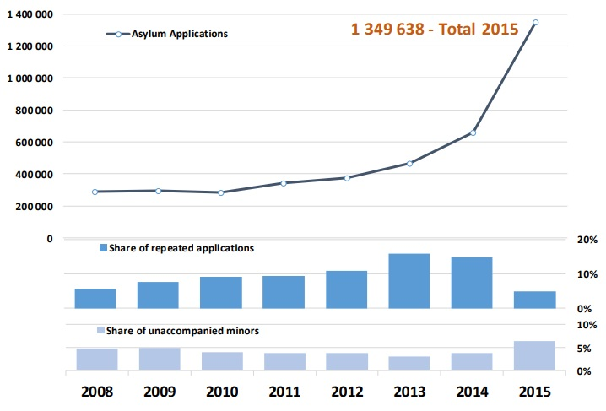
Number of applications for international protection in the EU+
Source: EASO, Latest asylum trends – 2015 overview.

Slide 8
Number of applications for international protection in the EU+
Own elaboration based on EASO, Latest asylum trends – 2015, 2016, 2017 overview.

Slide 9
Number of applications for international protection in Poland
12 325
12 319
10 753
8 193
5 078
Own elaboration based on: The Office for Foreigners, Annual comparision.

Slide 10
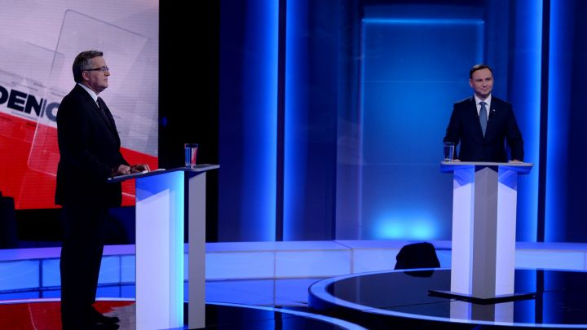
2015+
The "migration crisis" played a significant role, although it did not directly affect Poland, it triggered a widespread debate on the migration and integration of foreigners.

Slide 11
2015+
Along with the change of government (late 2015), one can observe a change of rhetoric in the field of migration and integration policy as well as withdrawal from the implementation of the existing strategic documents and agreements.
2016 – annulment of the strategic document "Polish Migration Policy – the Current State of Play and Proposed Actions".
2016 – new right-wing government (Law and Justice) against relocation mechanism agreed by previous center-right government (Civic Platform)

Slide 12
Anti-immigration rhetoric
2015+
„There are, after all, symptoms of very dangerous diseases that have not been seen in Europe for a long time. That does not mean discriminating someone ... But check it out.” – Jarosław Kaczyński
„It is impossible to verify the identity of people who came to Europe with waves […] We will not accept the automatic relocation mechanism […] safety is our priority and we will do everything to make Poland safe […] The state of emergency in France is a fact. I walked through the streets of Brussels today and saw soldiers with weapons. I do not want to see such images in Poland” – Mariusz Błaszczak

Slide 13
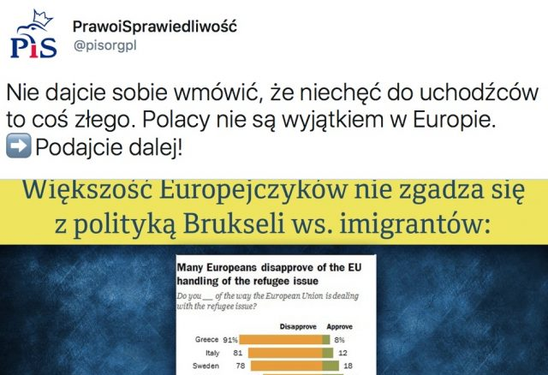
Anti-immigration rhetoric
2015+
„Do not let convince you that dislike for refugees is something bad” – Law and Justice tweet

Slide 14
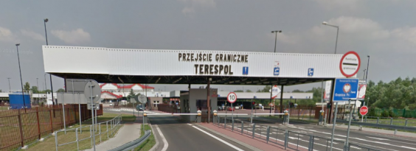
2015+
Violations of asylum procedure at the border crossing between Belarus and Poland (Brest-Terespol) 2016-2017:
Foreigners were denied entry into Poland,
Confidentiality was not guaranteed during interviews,
Some border guards conducting interviews had very limited knowledge of Russian.

Slide 15
2015+
Asylum, Migration and Integration Fund (FAMI)
Delays in the implementation, actually started operation in the second half of 2015 (established for the years 2014-2020),
One of the calls was annulled at the turn of 2015/2016,
No resolution of further calls.

Slide 16
Thank you
Dominik Wach
Centre of Migration Research, University of Warsaw
Warsaw Family Support Centre

